Slide 1
Section 01
React Native - Getting Started

Slide 2
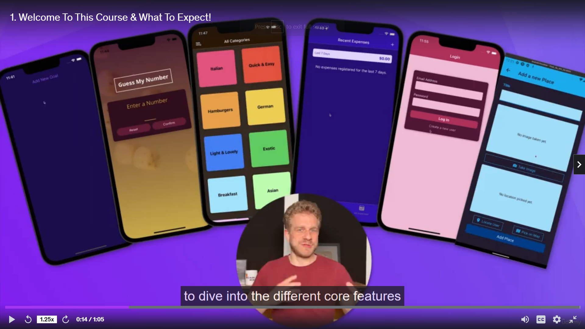
Welcome To This Course and What To Expect
Build Many Apps
Learn React Native from Ground up
Understand Core Features
React Native Build upon React So Prerequisite is to Know “React” and “JavaScript”

Slide 3
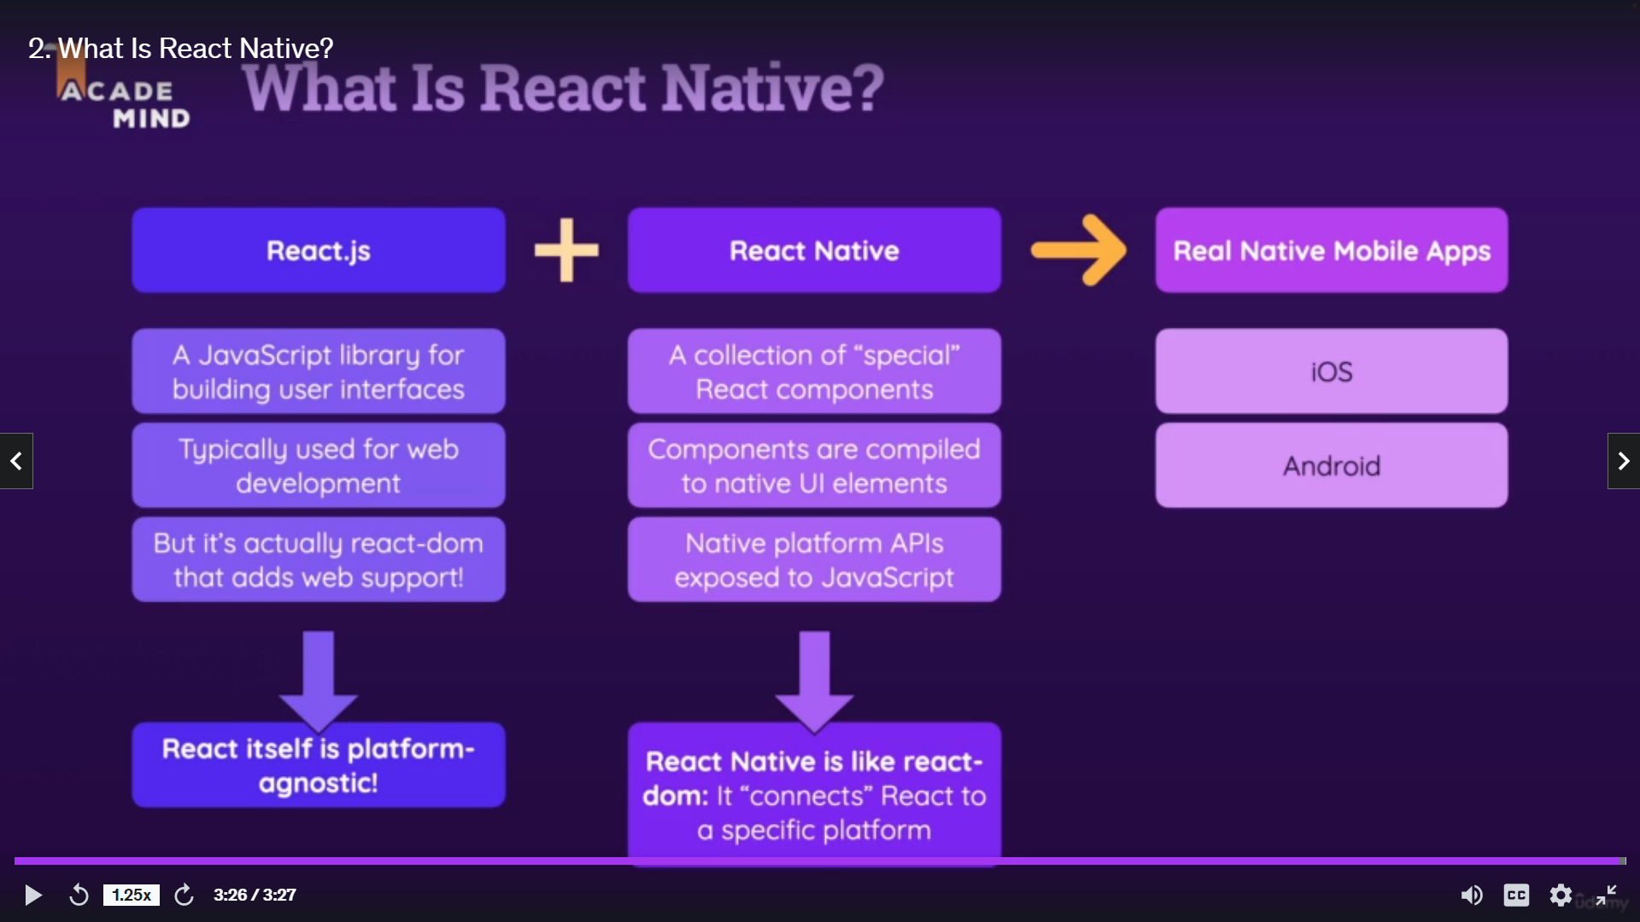

Slide 4
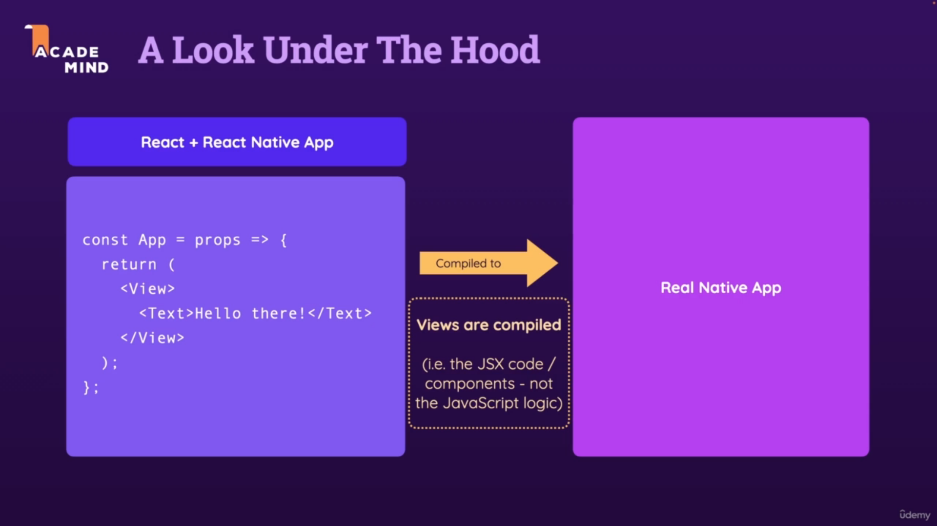
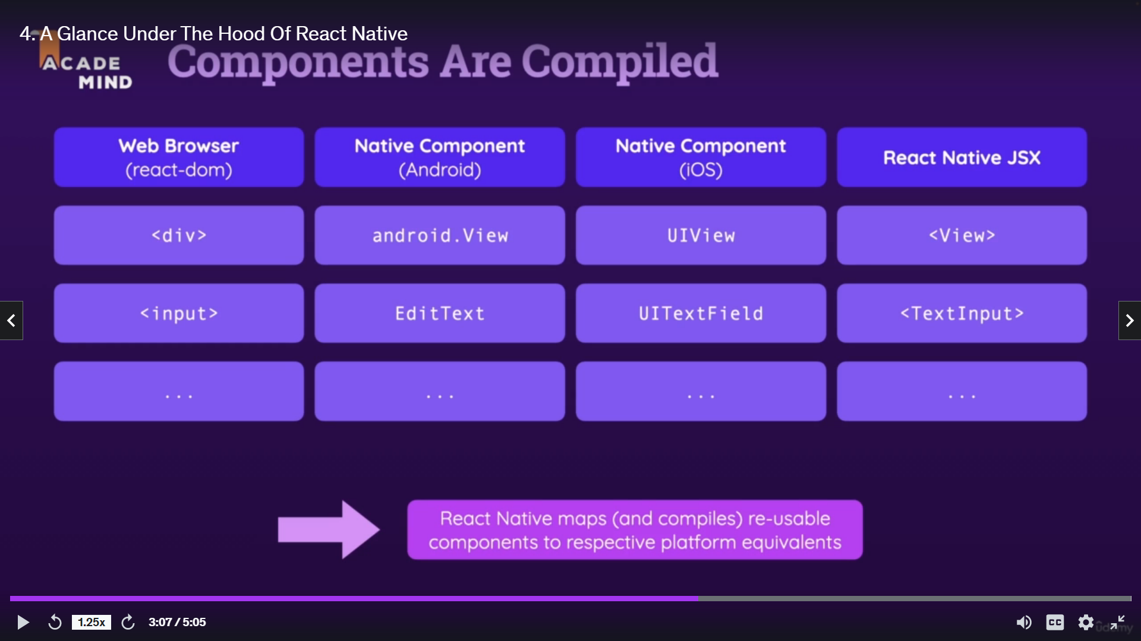
Join our Online Learning Community
Great to have you on board as a student!
This course also comes with free access to our “Academind Community” on Discord: https://academind.com/community/
There, you can find like-minded people, discuss issues, help each other, share progress, successes and ideas and simply have a good time!
I believe that you learn the most if you don't learn alone but find learning partners and other people with similar interests. Our community is a great place for this - it's the perfect complimentary resource for this course.
Joining it is of course free and 100% optional!

Slide 5
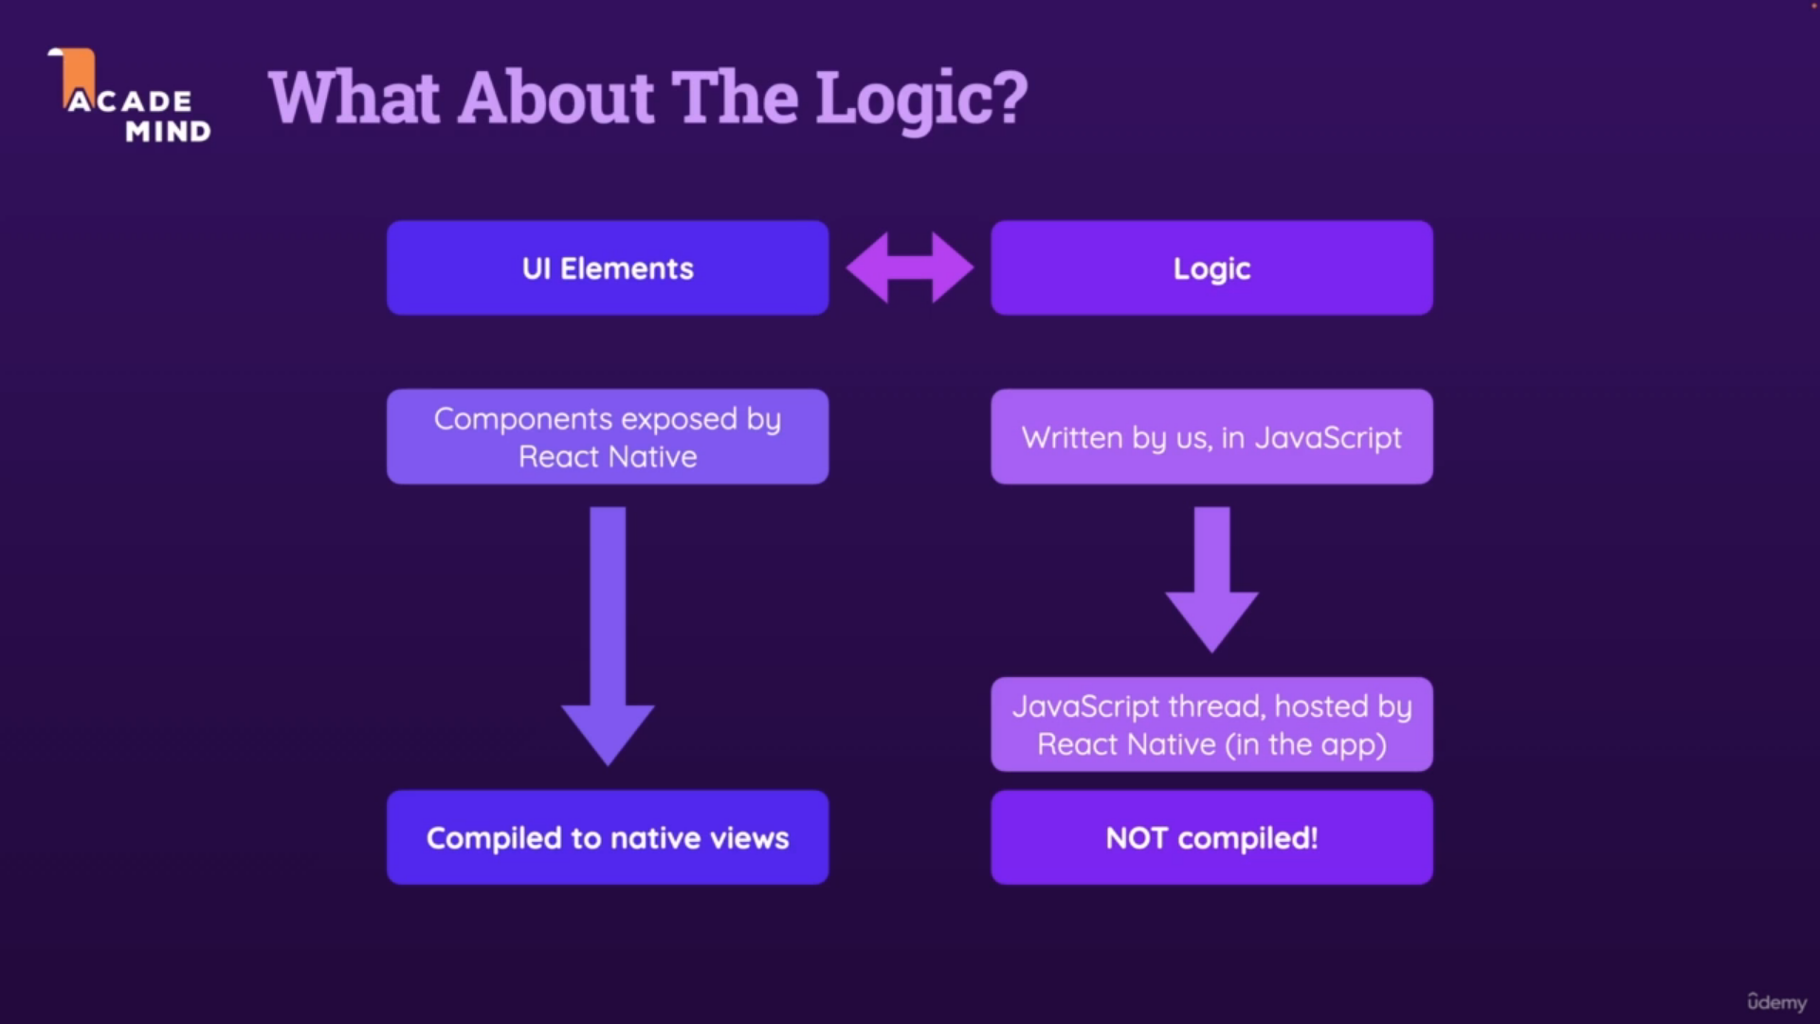

Slide 6
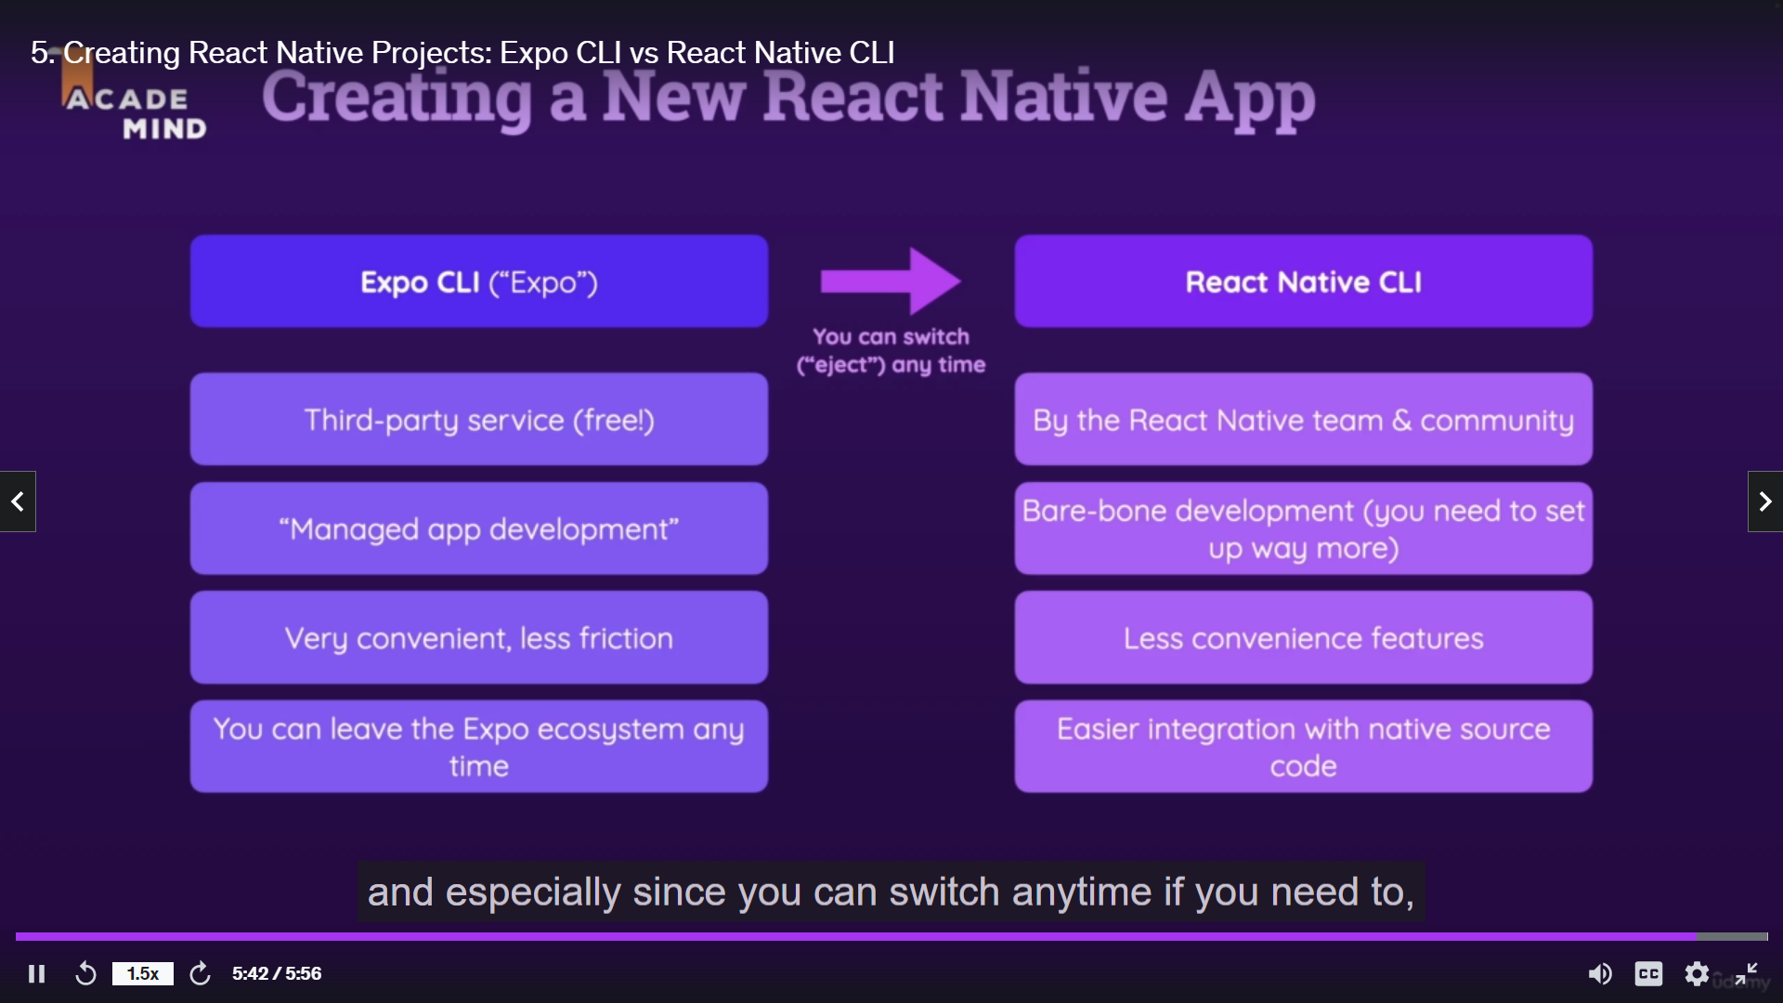
Creating React Native Projects: Expo CLI vs React Native CLI
CLI – Command Line Interface
Tools to Create React Native Projects
Expo CLI (“Expo”)
React Native CLI

Slide 7
Creating a New React Native Project
Step 1
npm install -g expo-cli
Step 2
expo init ProjectName
Step 3
cd ProjectName
Step 4
npm start # you can also use: expo start
Step 5
That’s it

Slide 8
Analyzing The Created Project
Understand all the Files and It is Uses.
Running Our First App On A Real Device!
Step 1:
Download Expo Go App from Play store
Step 2:
Start the Project by “npm start” command
Step 3:
Scan the QR Code (Computer and Phone Should be connected on Same Network)
Setting Up A Local Development Environment
Refer the Udemy Course Video to set Local Development Environment
That is How to Run Android and IOS Simulator on Laptop/Computer

Slide 9
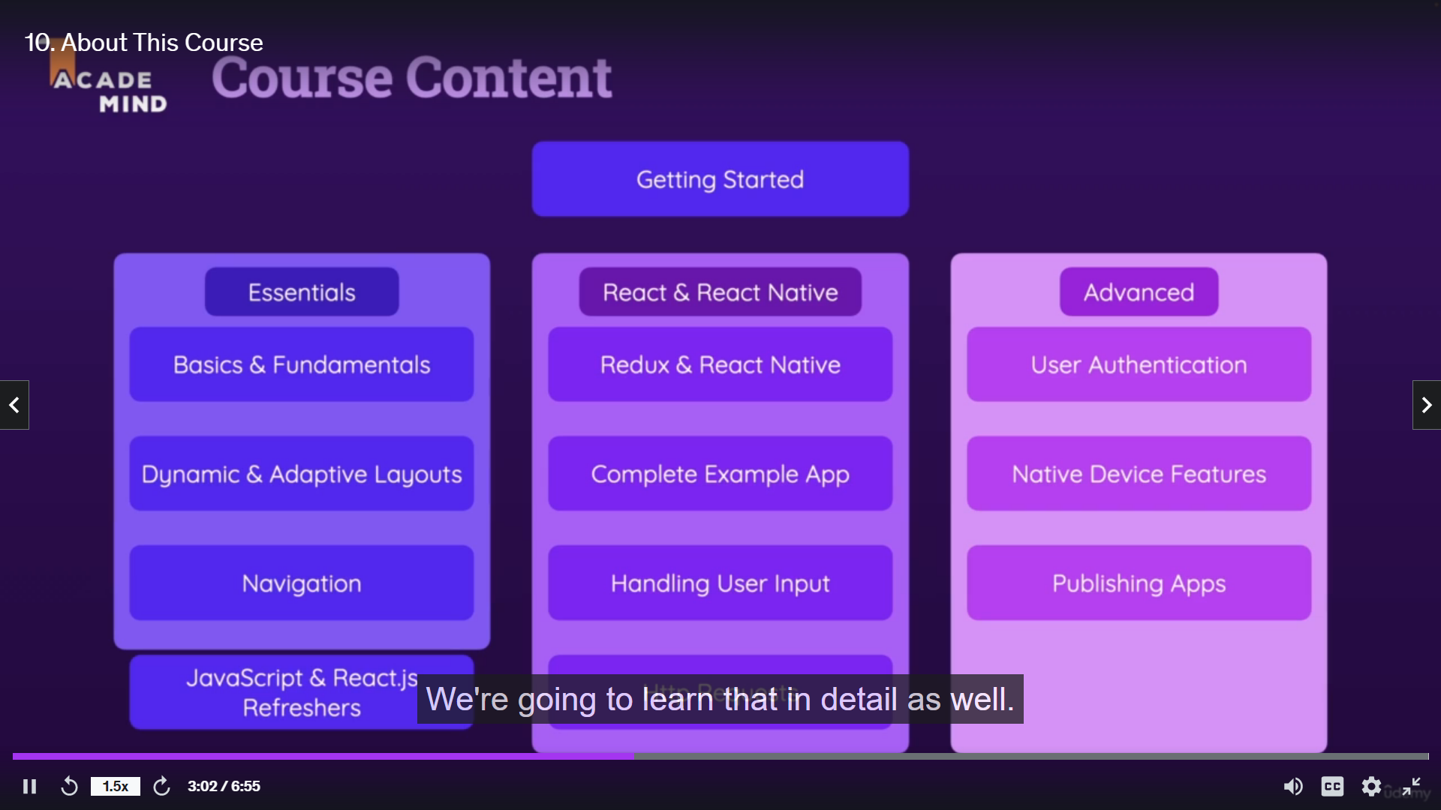

Slide 10
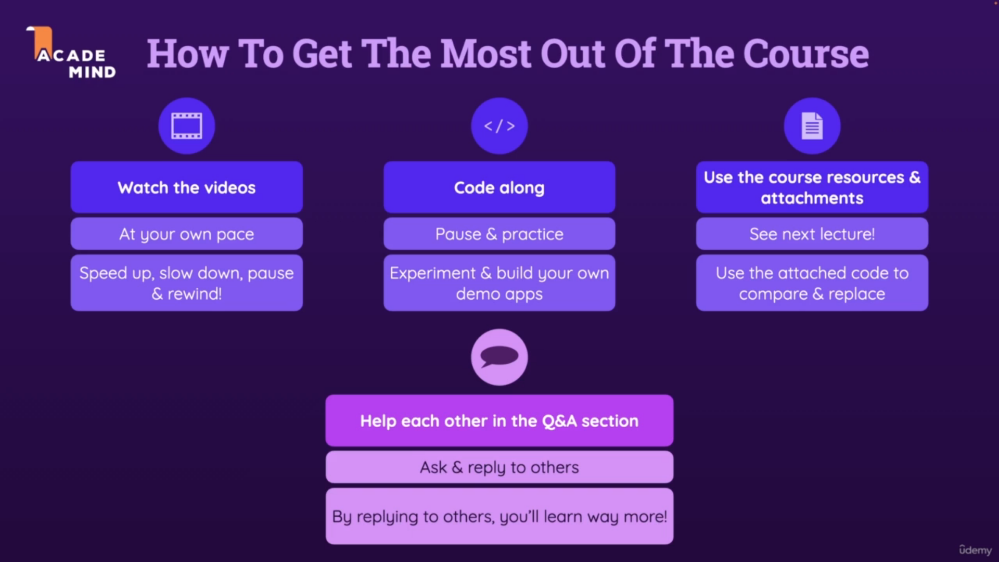

Slide 11
Course Resources, Code Snapshots & How To Use
You can find all course resources + instructions on how to use them in this GitHub repository: https://github.com/academind/react-native-practical-guide-code
This repository is organized into branches => Every branch represents a course section and includes the resources that belong to the respective course section.
Provided resources are:
Code snapshots (for you to compare against your code, when coding along)
Slides
Extra resources (e.g., images used in a section)
For usage instructions, please visit the linked repository and read the instructions you find there.

Slide 12
Section 02
React Native Basics
{Course Goals App}
Refer Code

Slide 13
Section 03
Debugging – React Native Apps
Introduction

Slide 14
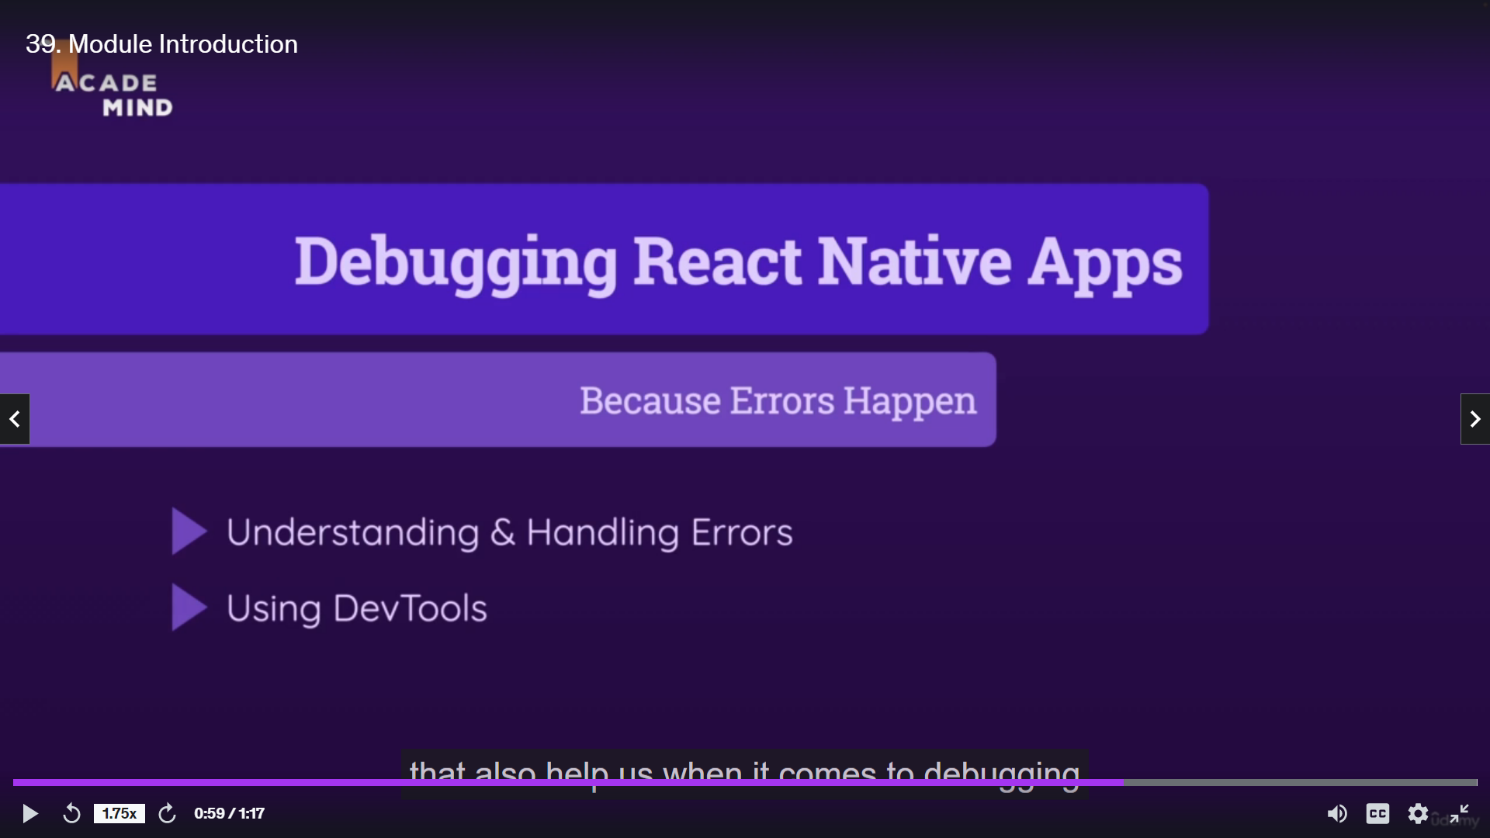

Slide 15
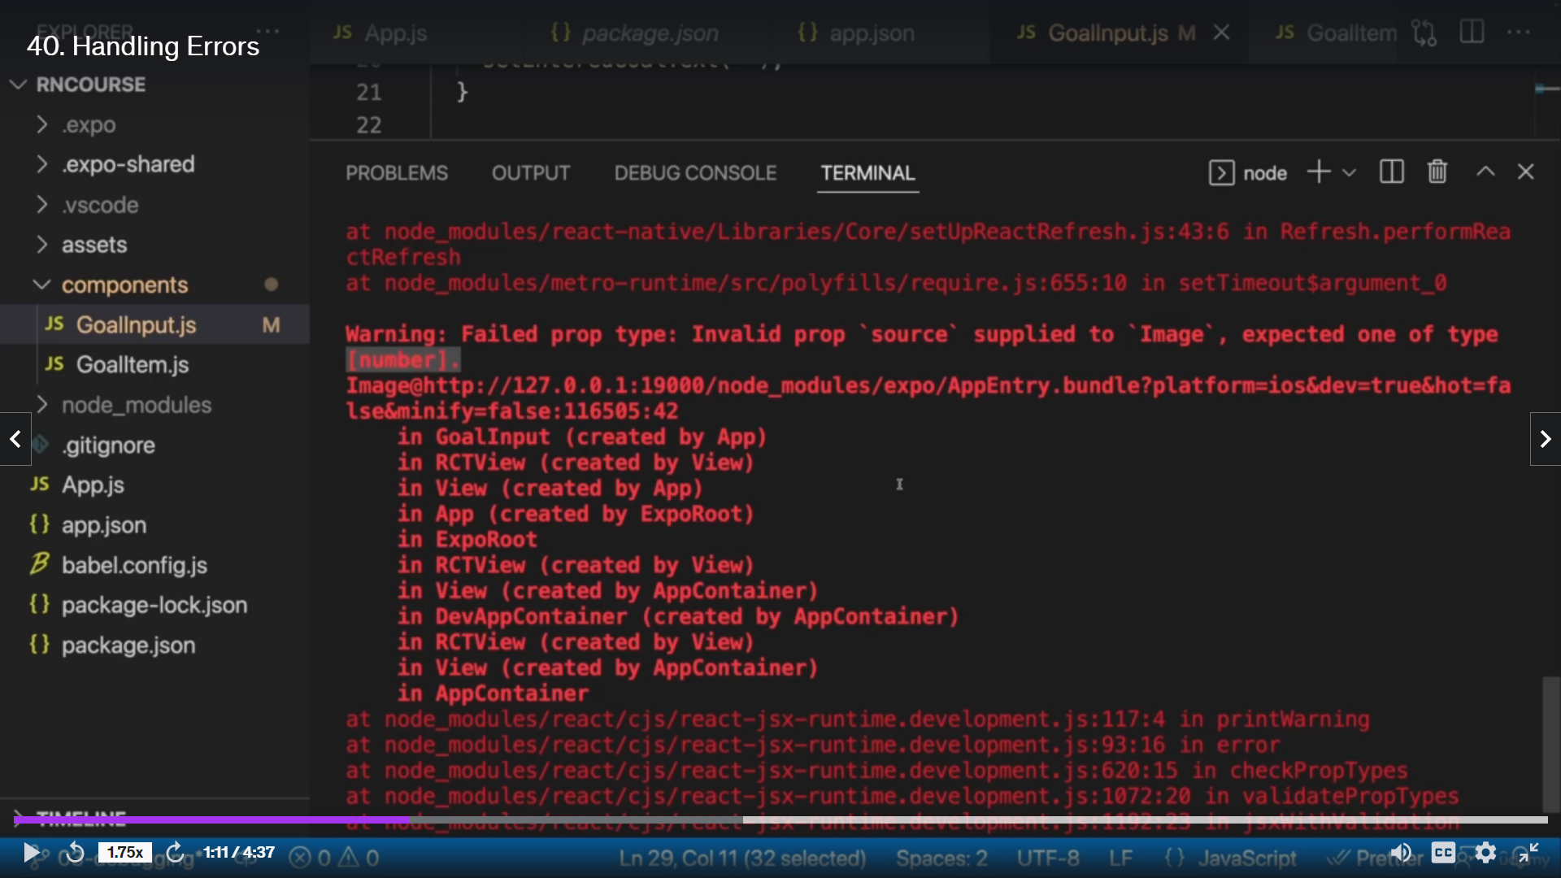

Slide 16
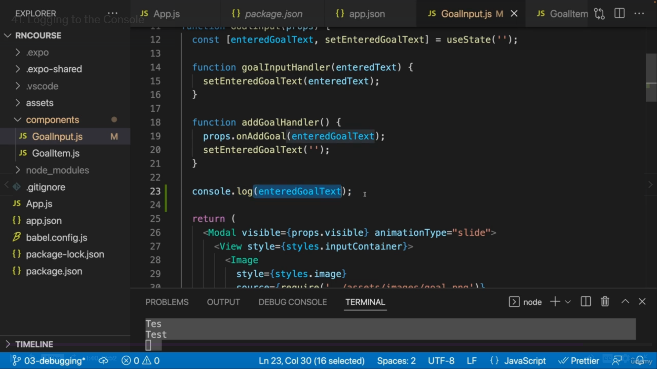
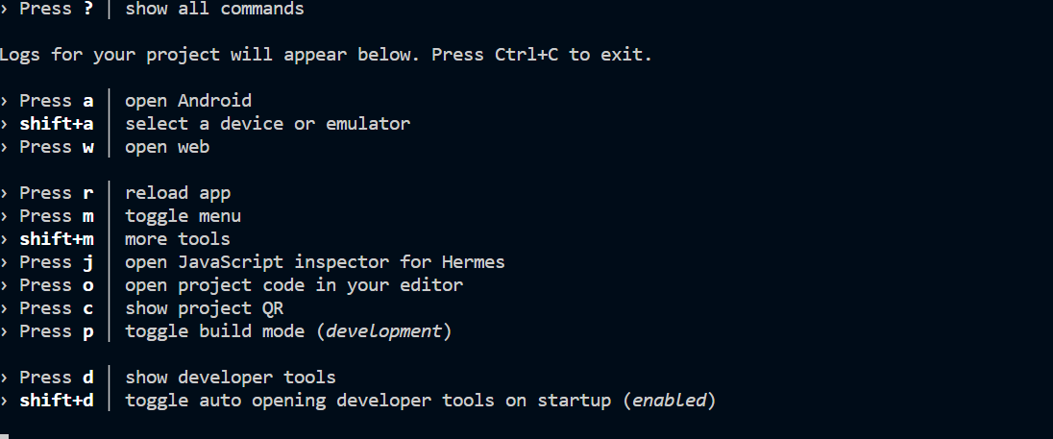




Slide 17
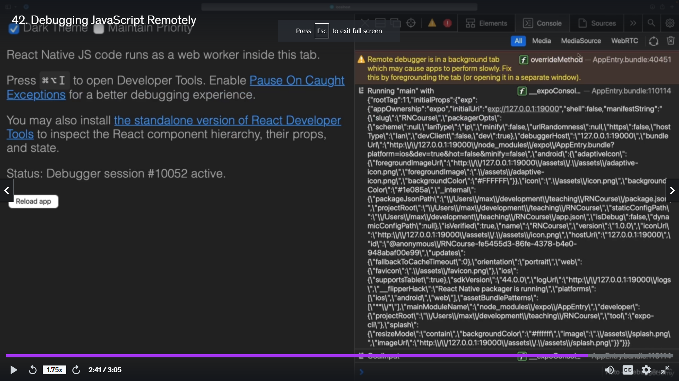

Slide 18
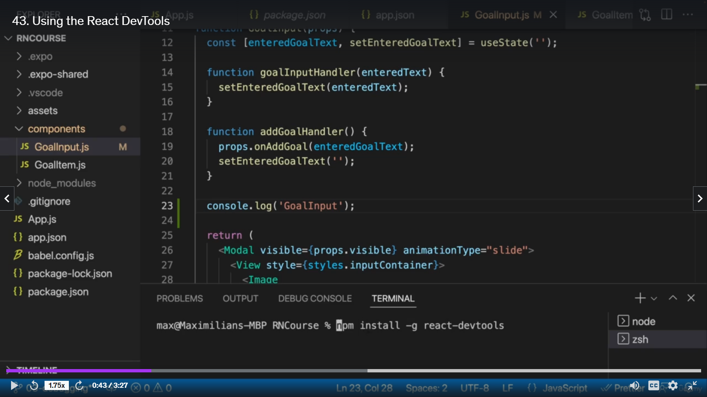


Slide 19
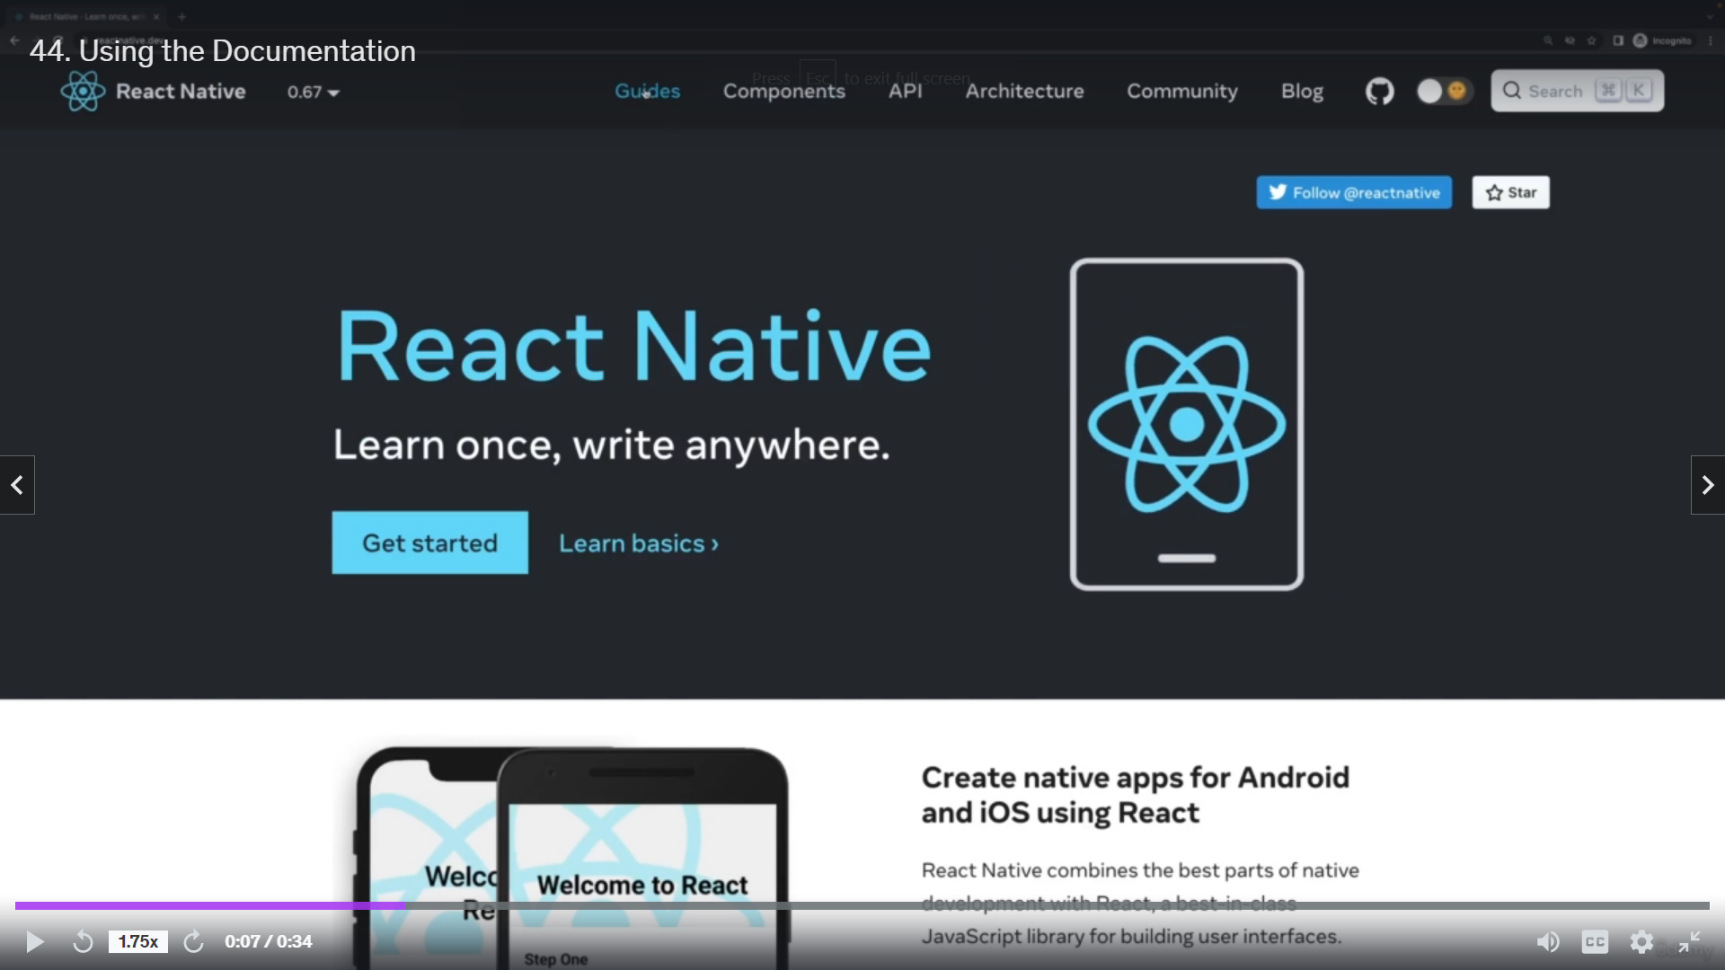


Slide 20
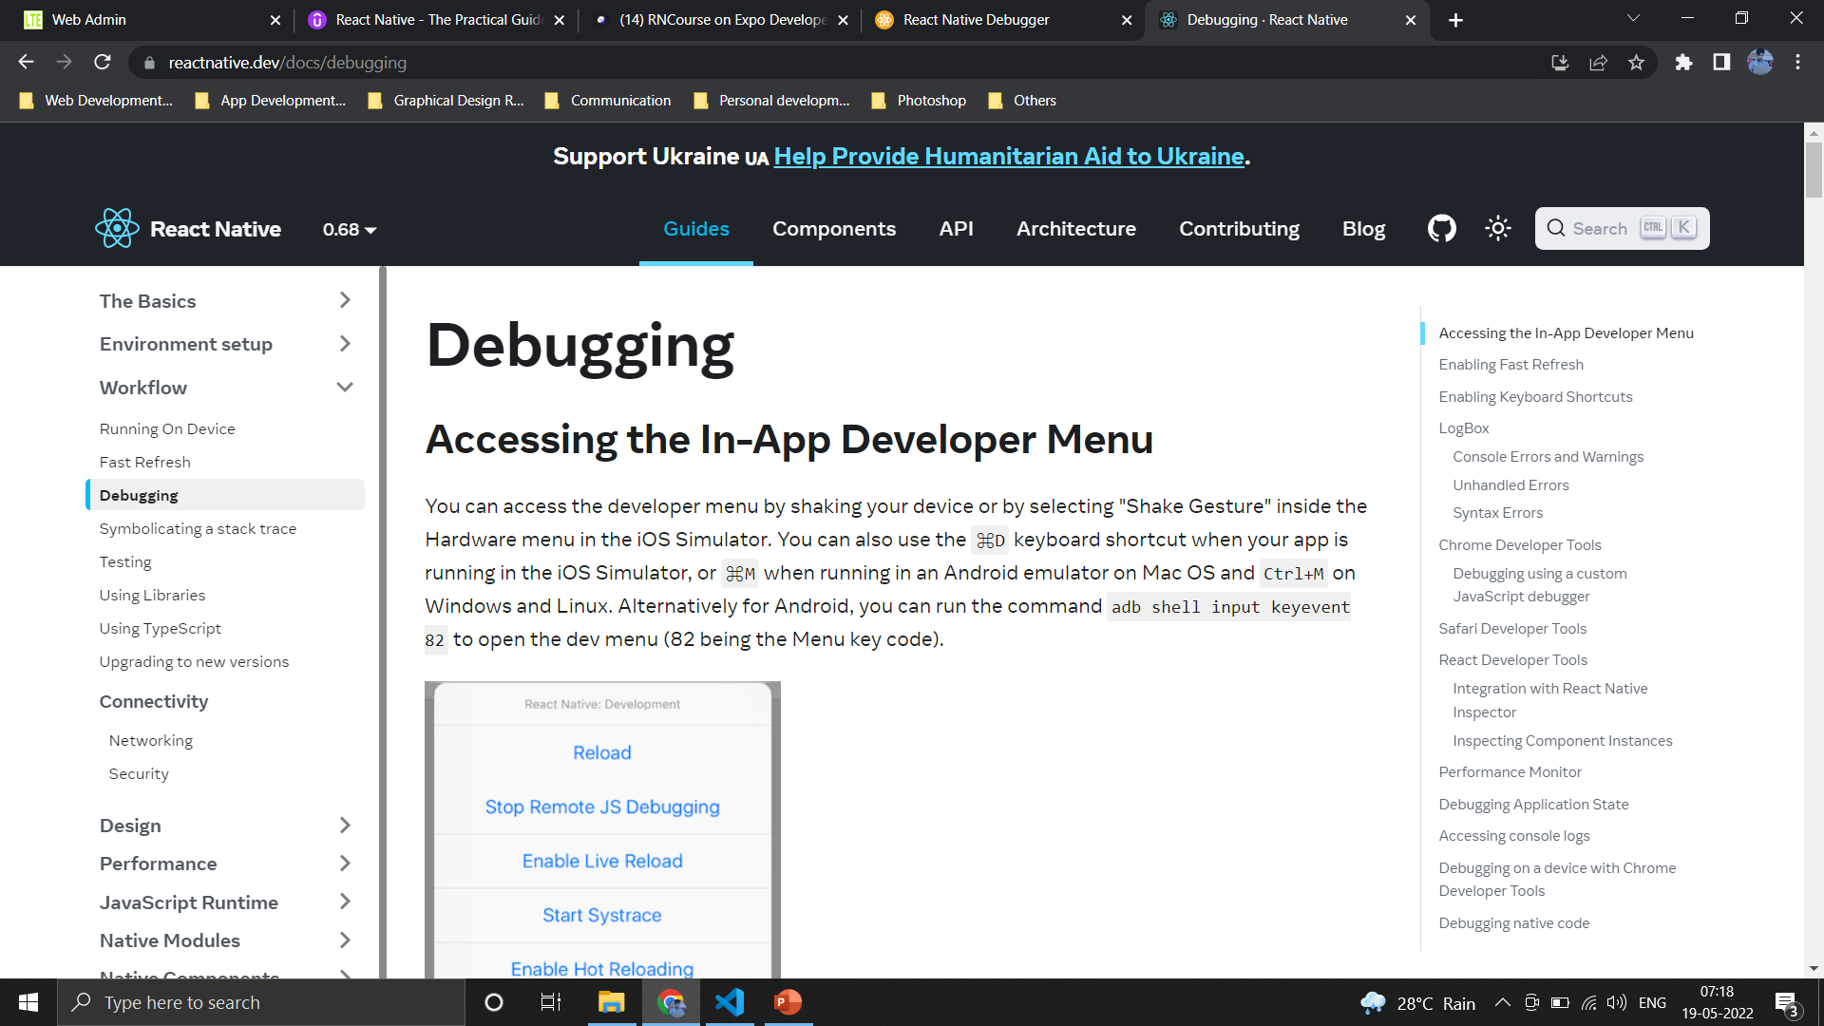

Slide 21
Section 06
React Native Navigation with
React Navigation
{Meals App}

Slide 22
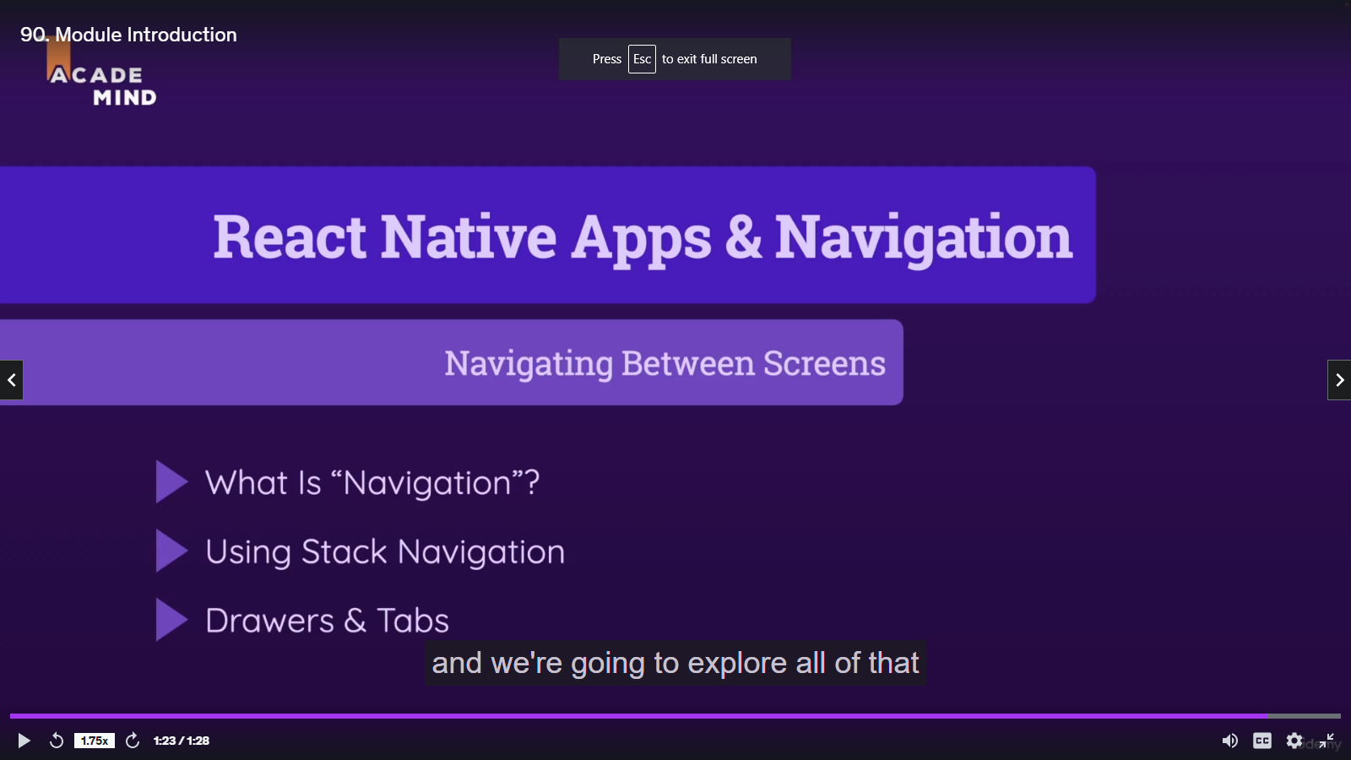

Slide 24
Section 16
Course Roundup

Slide 25
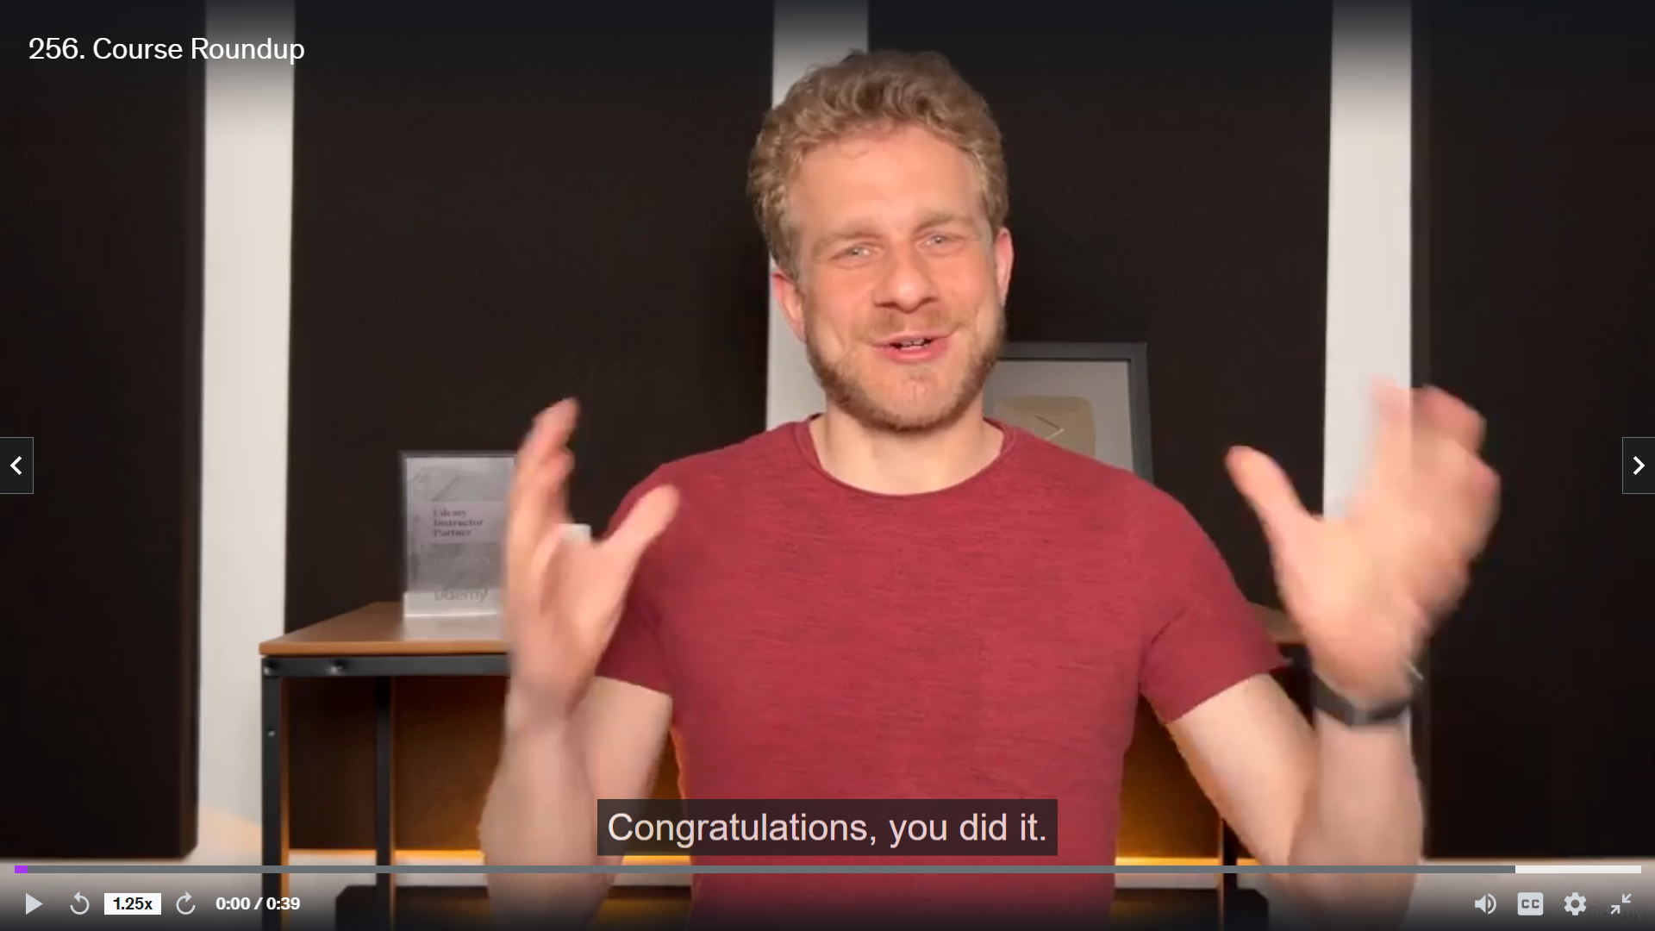

Slide 26
Section 17
Bonus - JavaScript Refresher

Slide 27
Module Introduction
JavaScript Basics
A Quick Refresher
JavaScript
JavaScript is a scripting language that enables you to create dynamically updating content, control multimedia, animate images, and pretty much everything else.
Scripting Language
Scripting languages are a specific kind of computer languages that you can use to give instructions to other software, such as a web browser, server, or standalone application. Many of today's most popular coding languages are scripting languages, such as JavaScript, PHP, Ruby, Python, and several
How JavaScript Works?
JavaScript is an interpreted language that means it gets executed in line by line manner (or which means the JavaScript engine converts the Js code line by line and runs in the same manner instead of converting the whole program once).

Slide 28
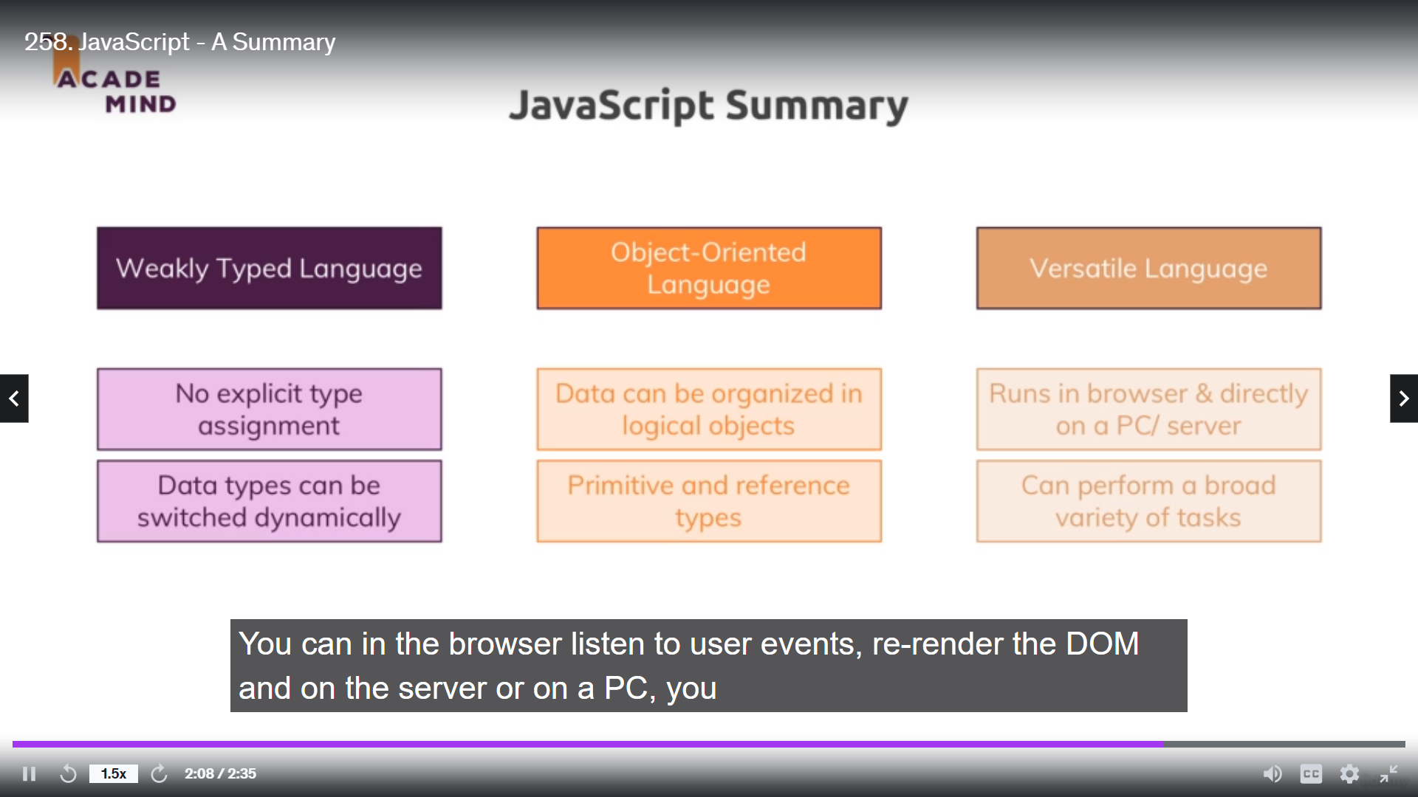

Slide 29
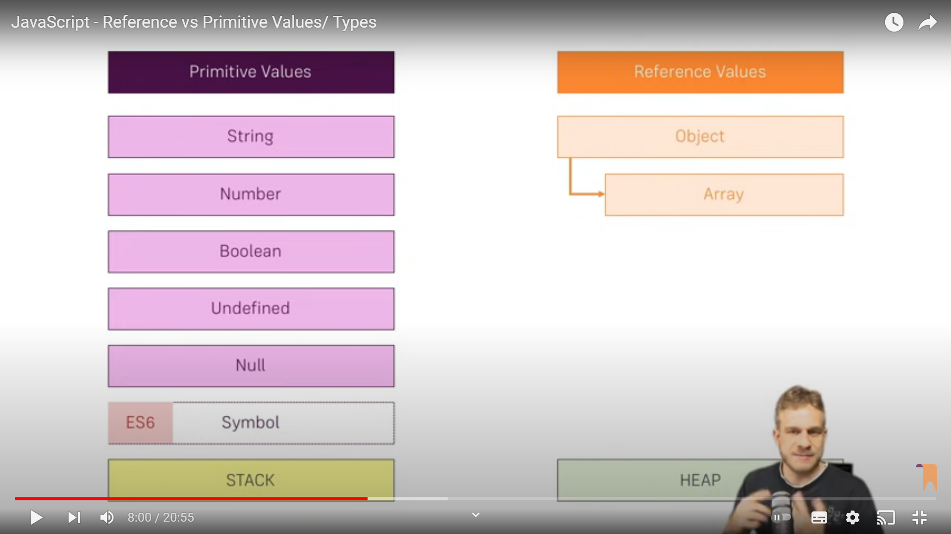
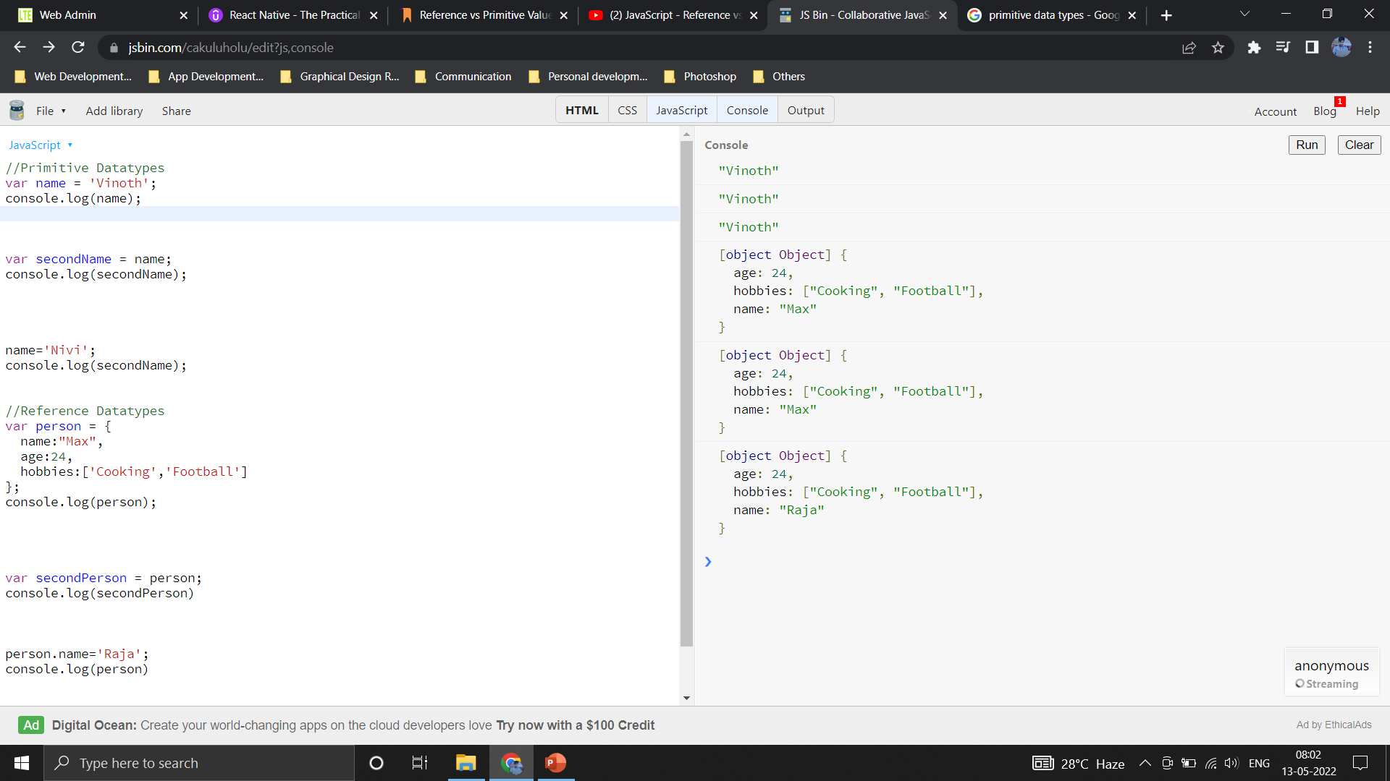
Project Setup
This module is taken from my NodeJS course - but it's a standalone JavaScript refresher.
We'll execute the code examples with NodeJS, hence you should ensure that you downloaded + installed that from https://nodejs.org/
Reference vs Primitive Values
https://academind.com/tutorials/reference-vs-primitive-values

Slide 30
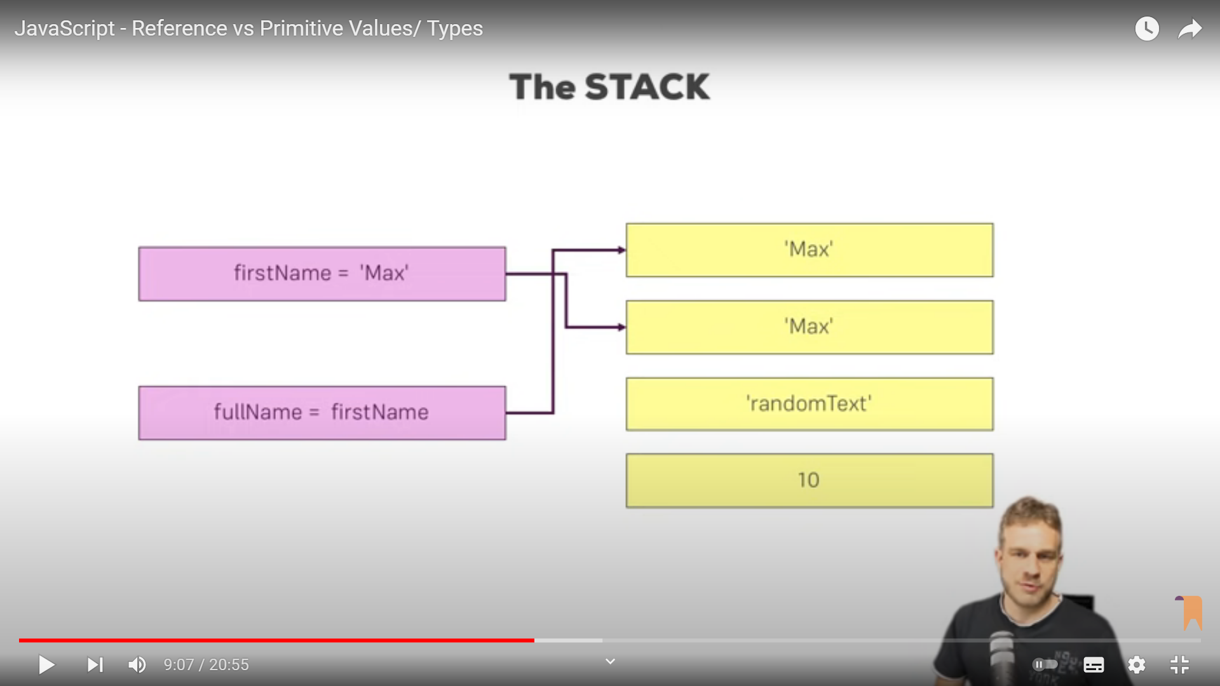
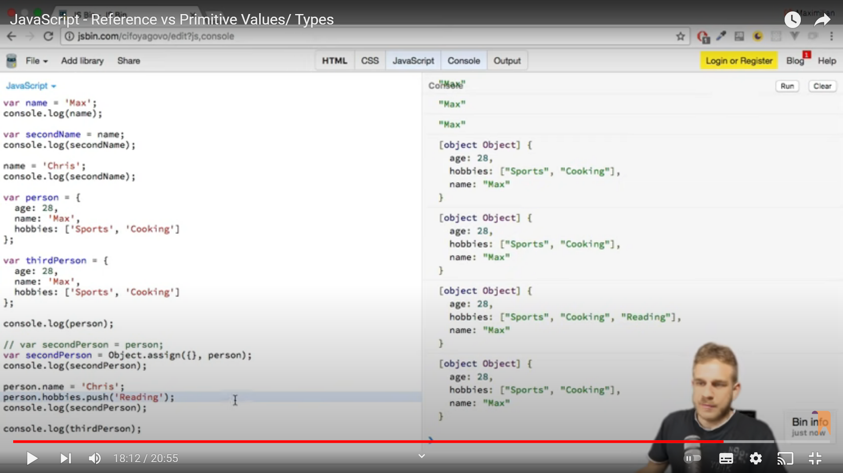
Reference Code
https://jsbin.com/foteguj

Slide 31
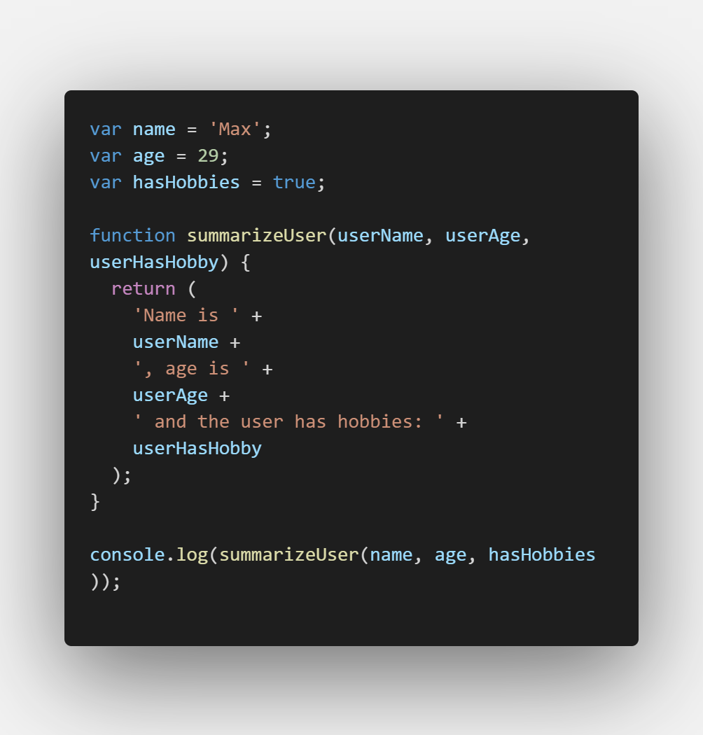
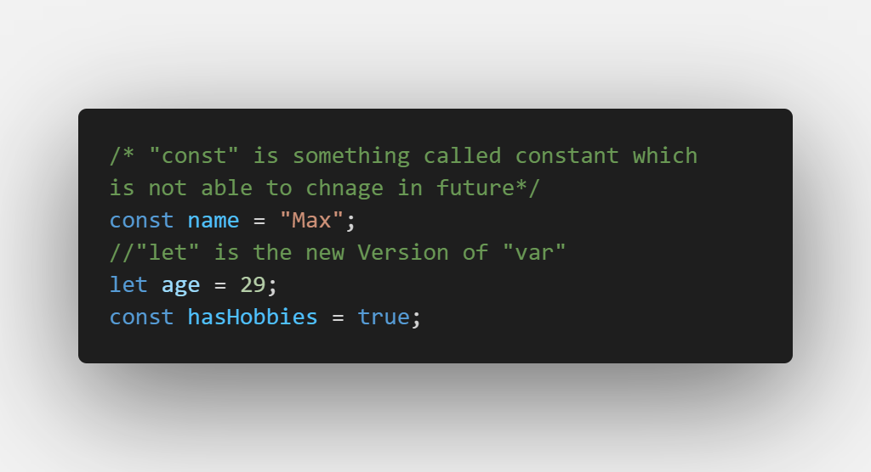
Core Syntax Refresher
Reference Sites
https://developer.mozilla.org/en-US/docs/Learn/JavaScript
https://academind.com/tutorials?filter=javascript
https://academind.com/tutorials/reference-vs-primitive-values
let and const

Slide 32
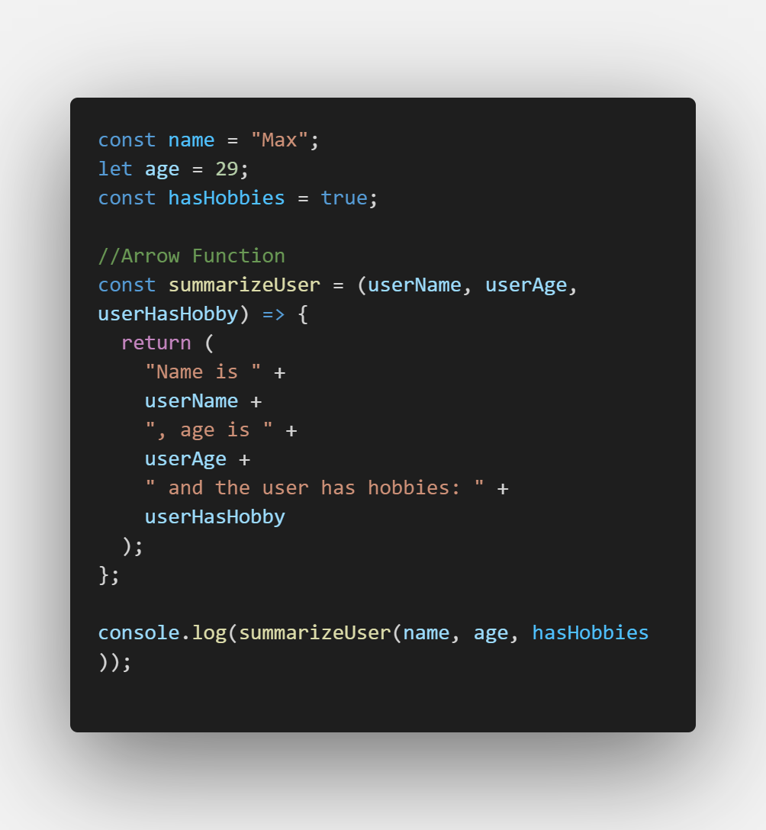
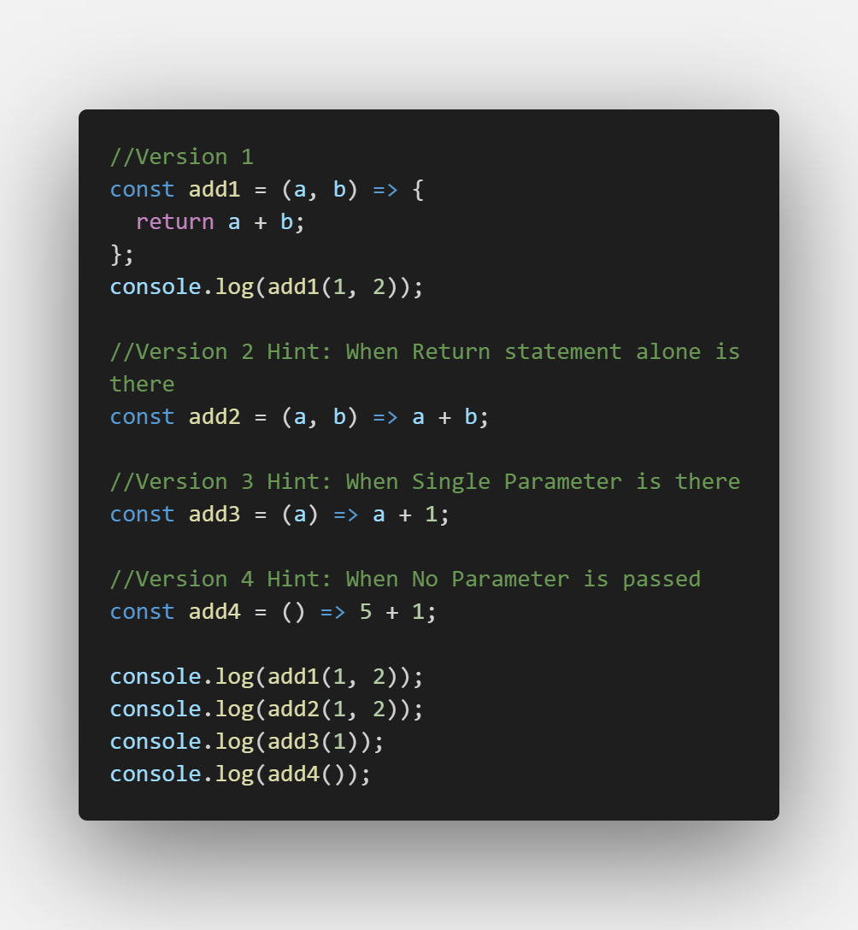
Arrow Functions
Reference Sites (Not seen)
Why to use Arrow Function Instead of Normal Function
https://academind.com/tutorials/this-keyword-function-references
Different ways to write Arrow Functions
Hint : Function without Name is called as Anonymous Function

Slide 33
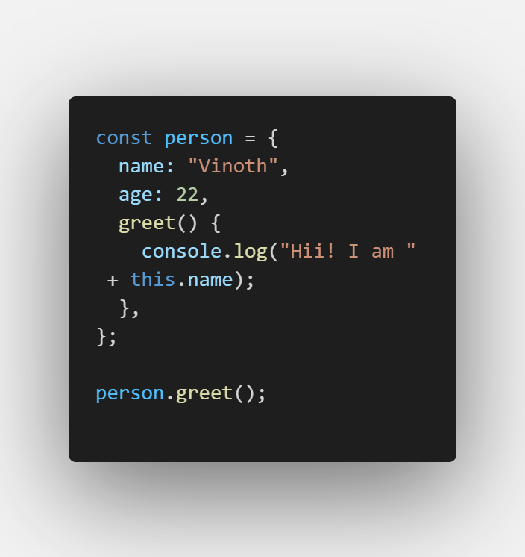
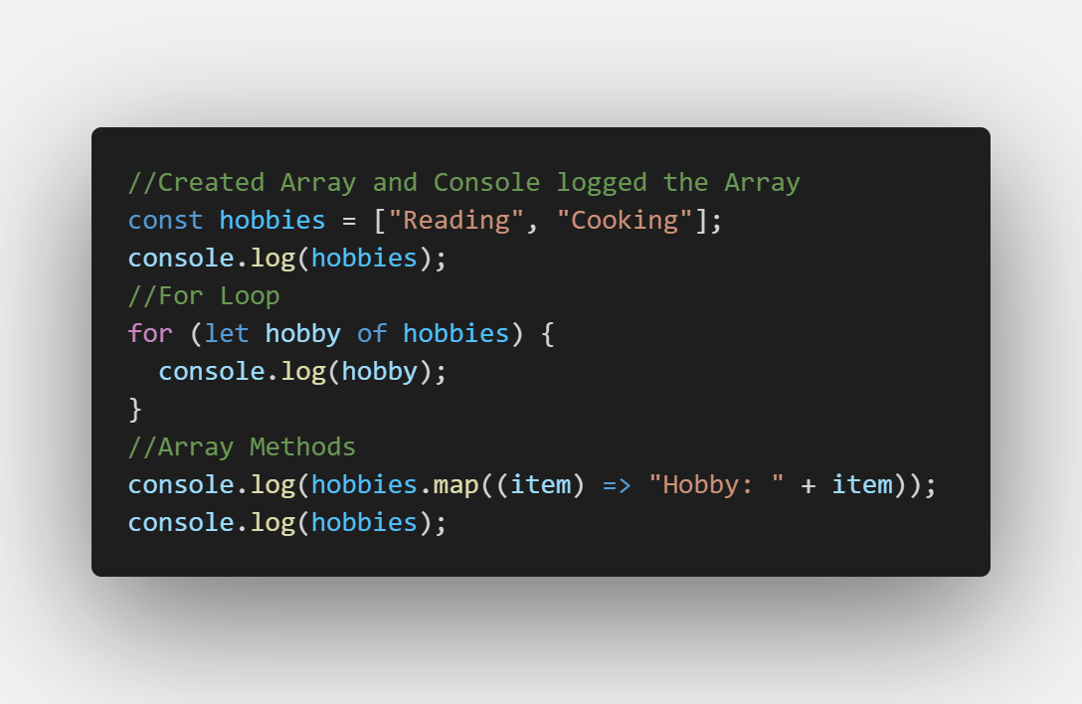
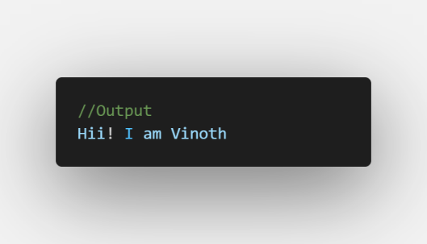
Objects: Properties and Methods
Reference Sites
https://developer.mozilla.org/en-US/docs/Web/JavaScript/Reference/Global_Objects/Array#
Arrays and Array Methods

Slide 34
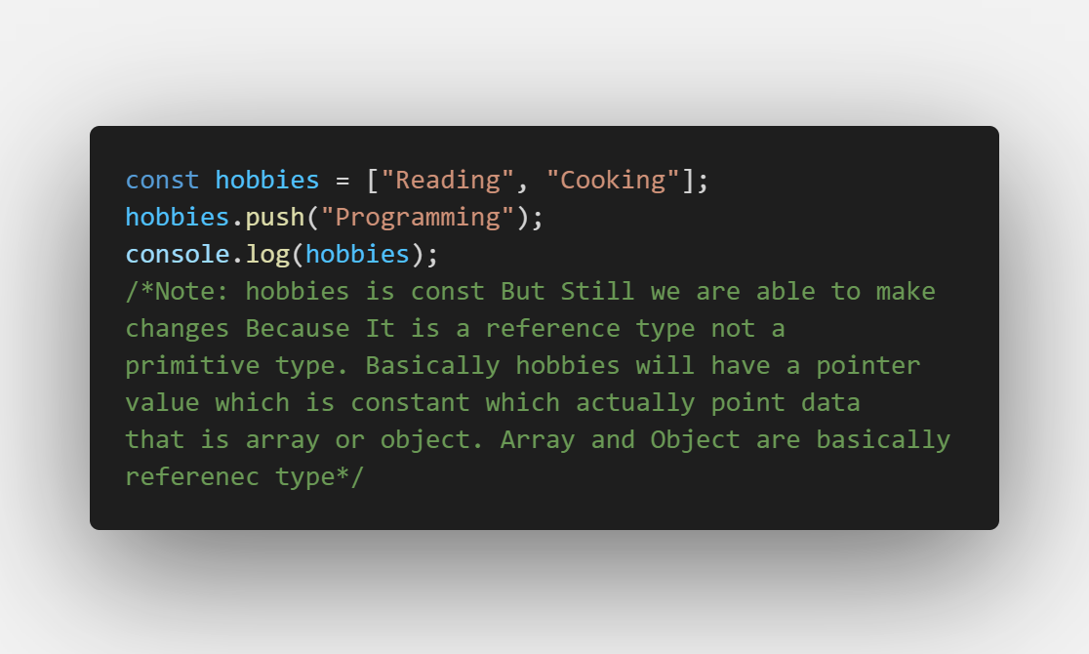
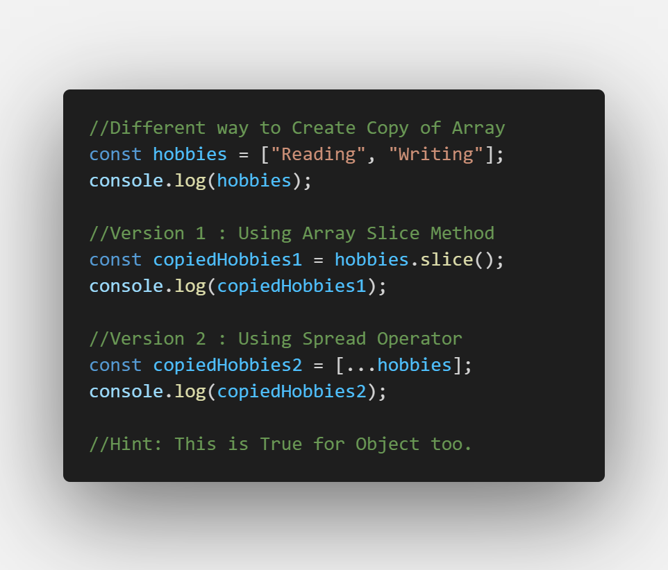
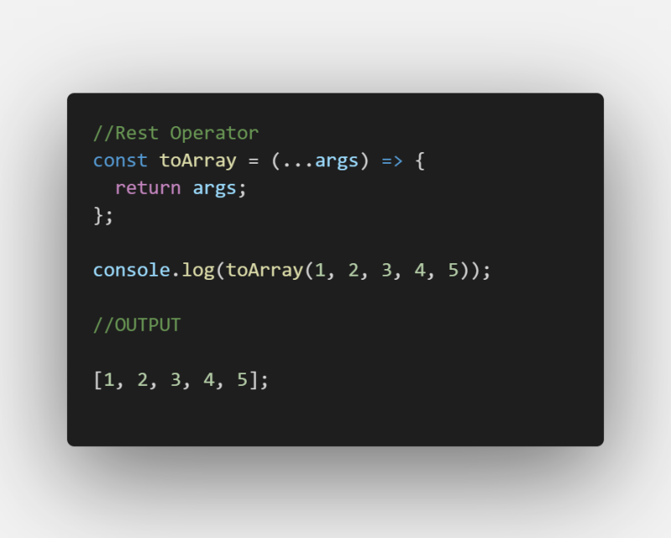
Arrays, Objects and Reference Types
Spread Operator
Rest Operator
Reference Sites
https://www.freecodecamp.org/news/javascript-rest-vs-spread-operators/

Slide 35
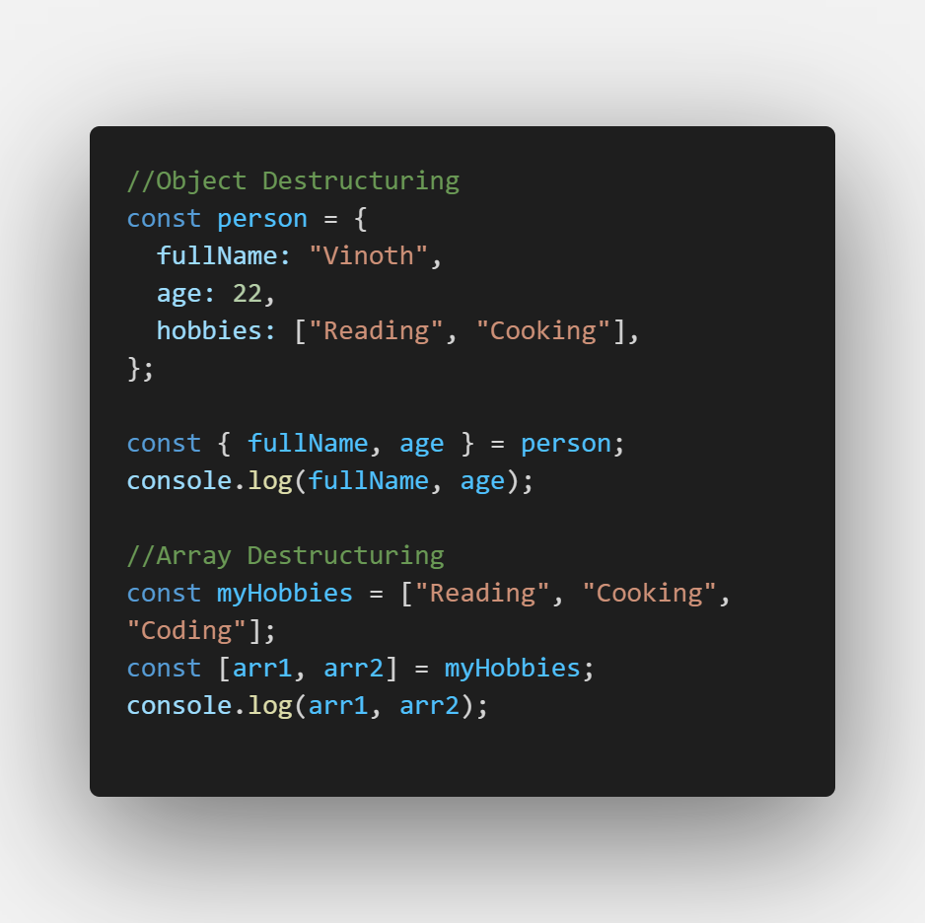
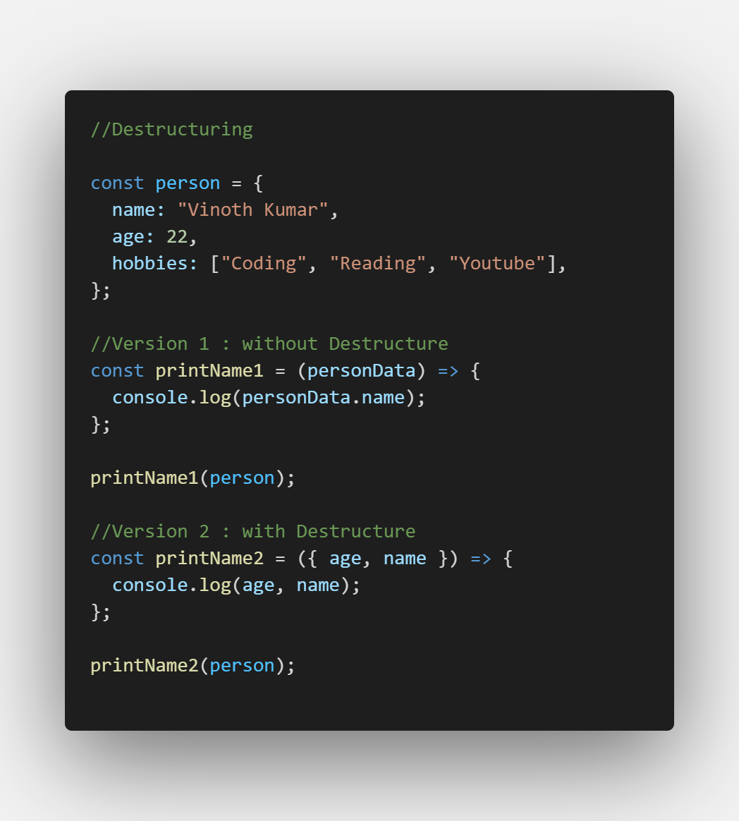
Destructuring Concept
Reference Sites
https://hacks.mozilla.org/2015/05/es6-in-depth-destructuring/

Slide 36
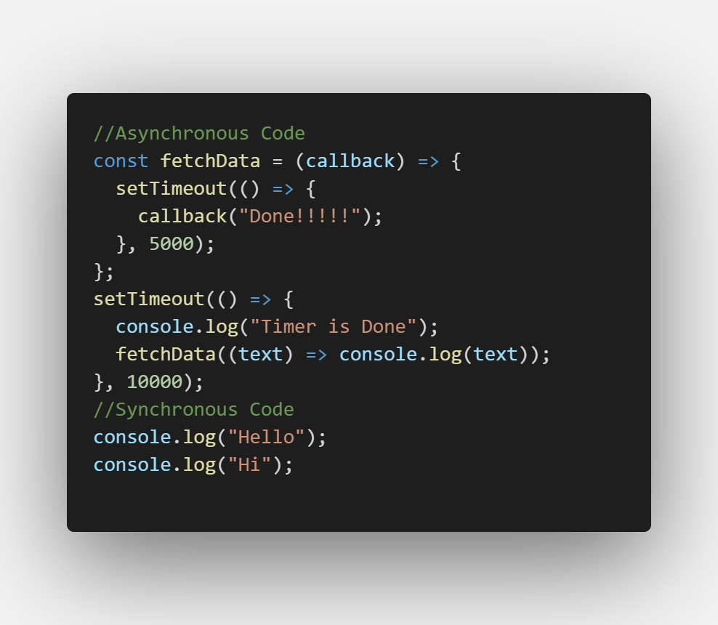
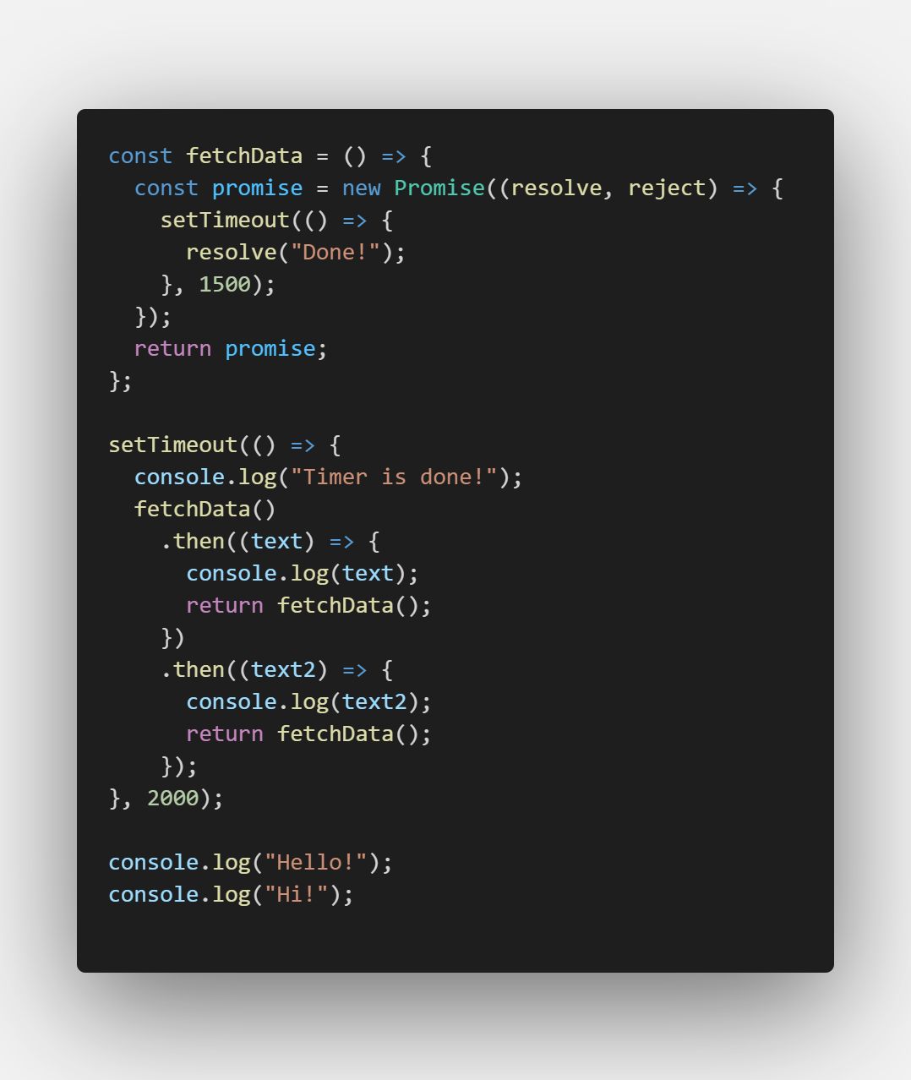
Async Code and Promises
callback
promise
Reference Sites

Slide 37
Bonus - JavaScript Refresher
Completed

Slide 38
Section 18
Bonus – React.js Refresher

Slide 39
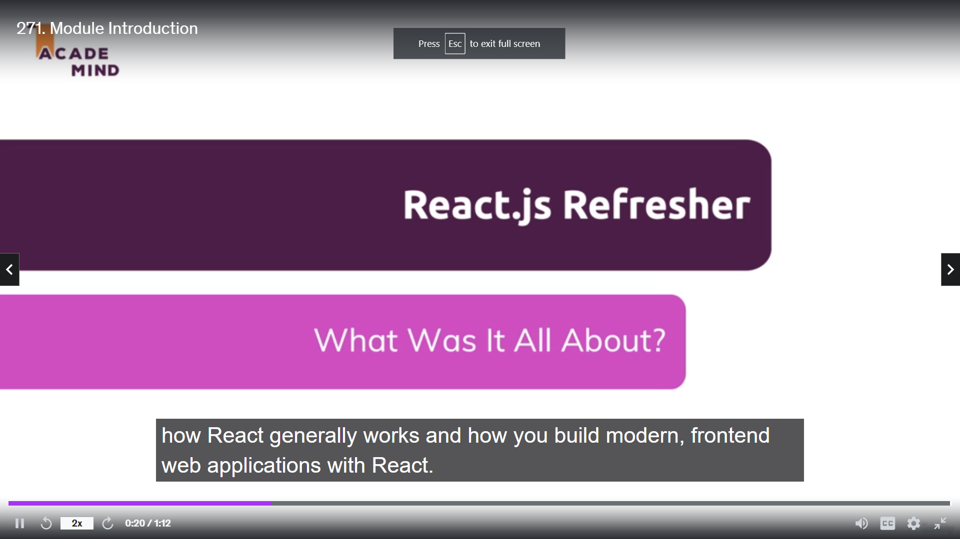
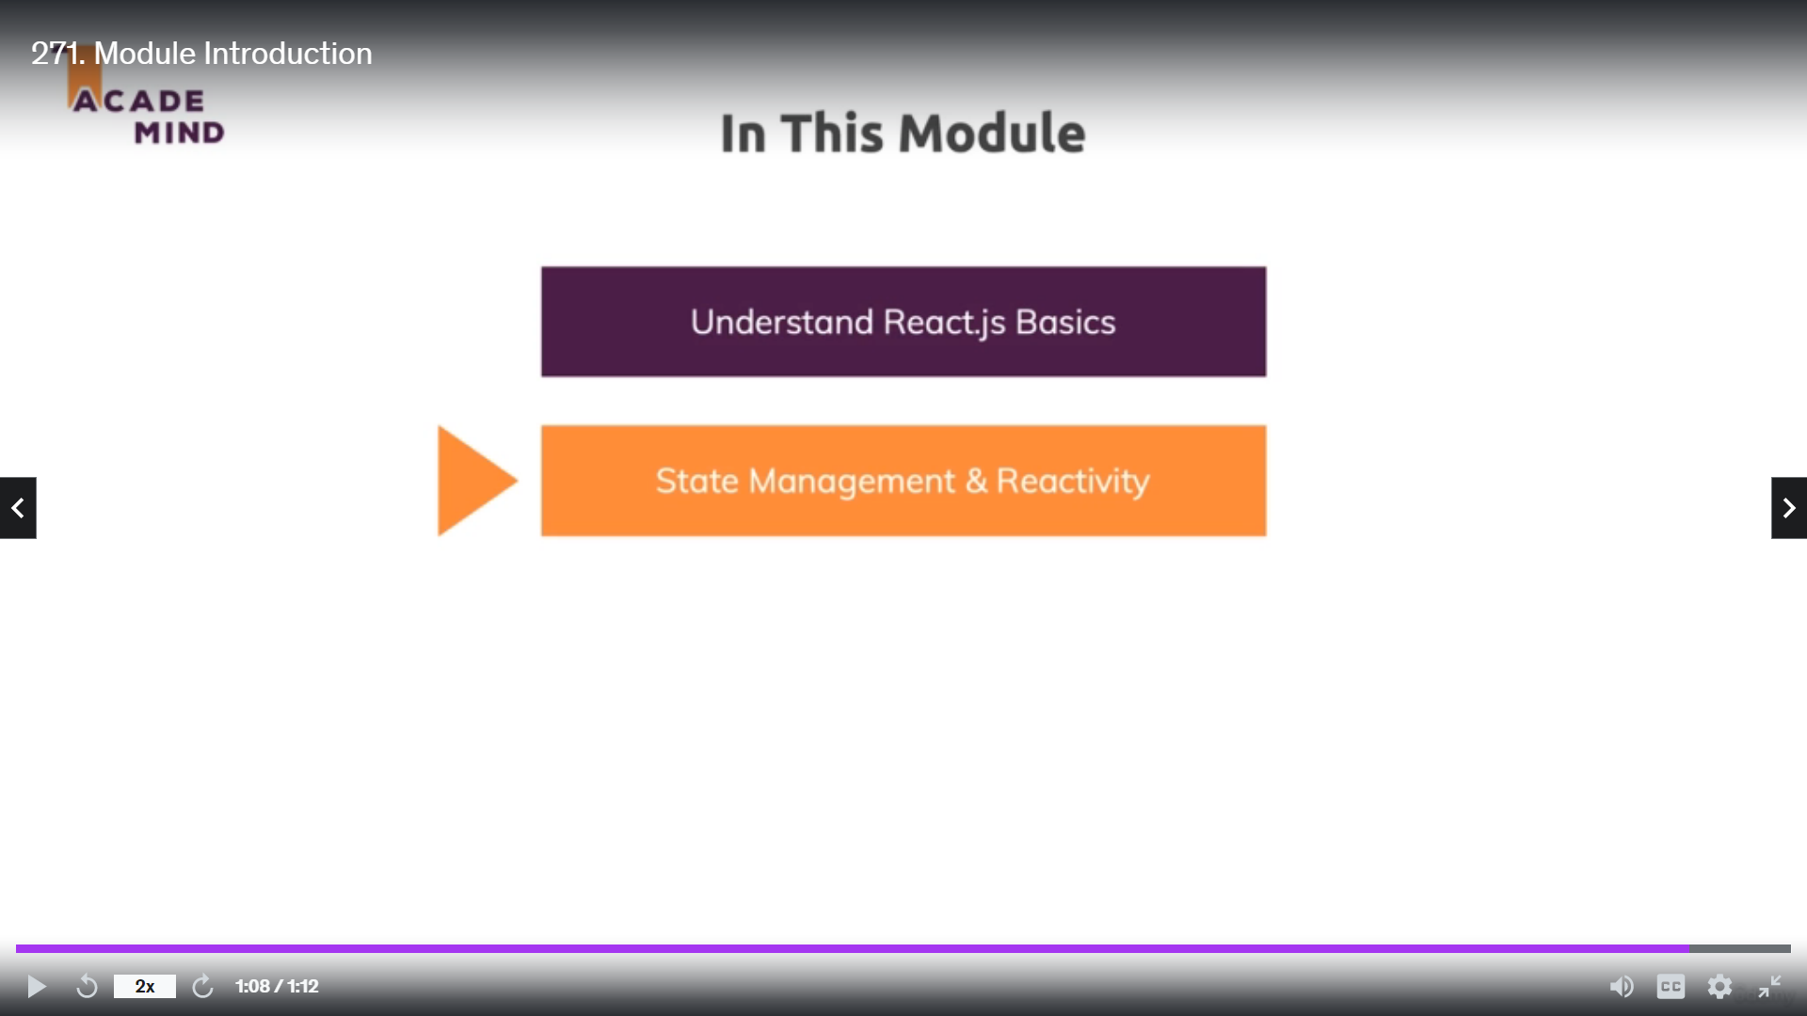
Module Introduction
React.js Refresher
A Quick Refresher

Slide 40
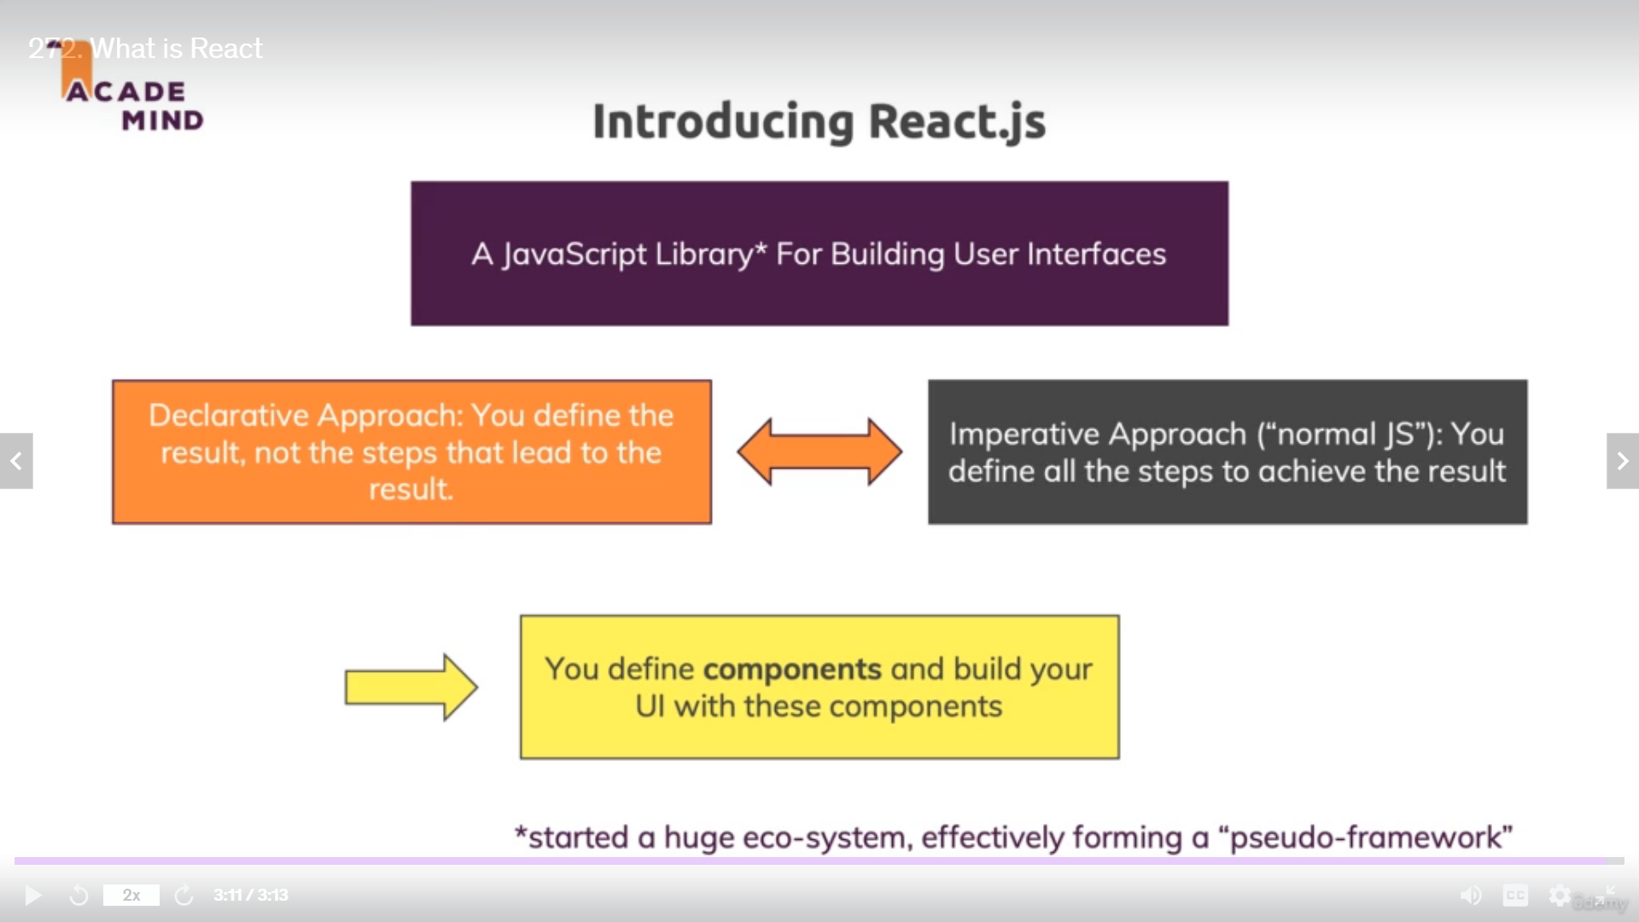

Slide 41
Concepts You Learn By Below Project
What is React
Understanding JSX
Understanding Components
Working with Multiple Components
Working with Props
Rendering Lists of Data
Handling Events
Parent Child Communication
Managing State
More on State
User Input and Two way Binding
Wrap up
Tap this to Refer Project
Refer the Below Project for React JS Refresher

Slide 42
Section 19
Bonus

Slide 43
Legacy Course Content

Slide 44
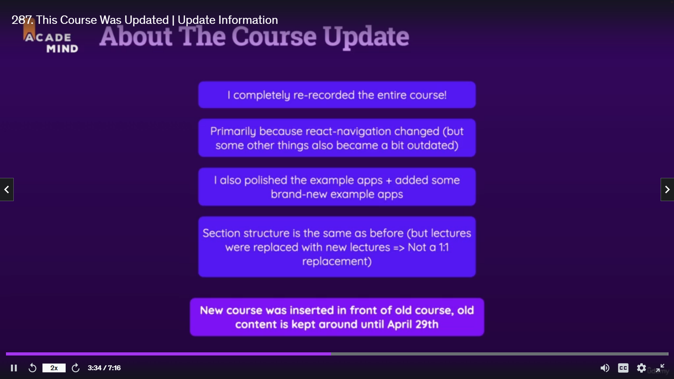

Slide 45
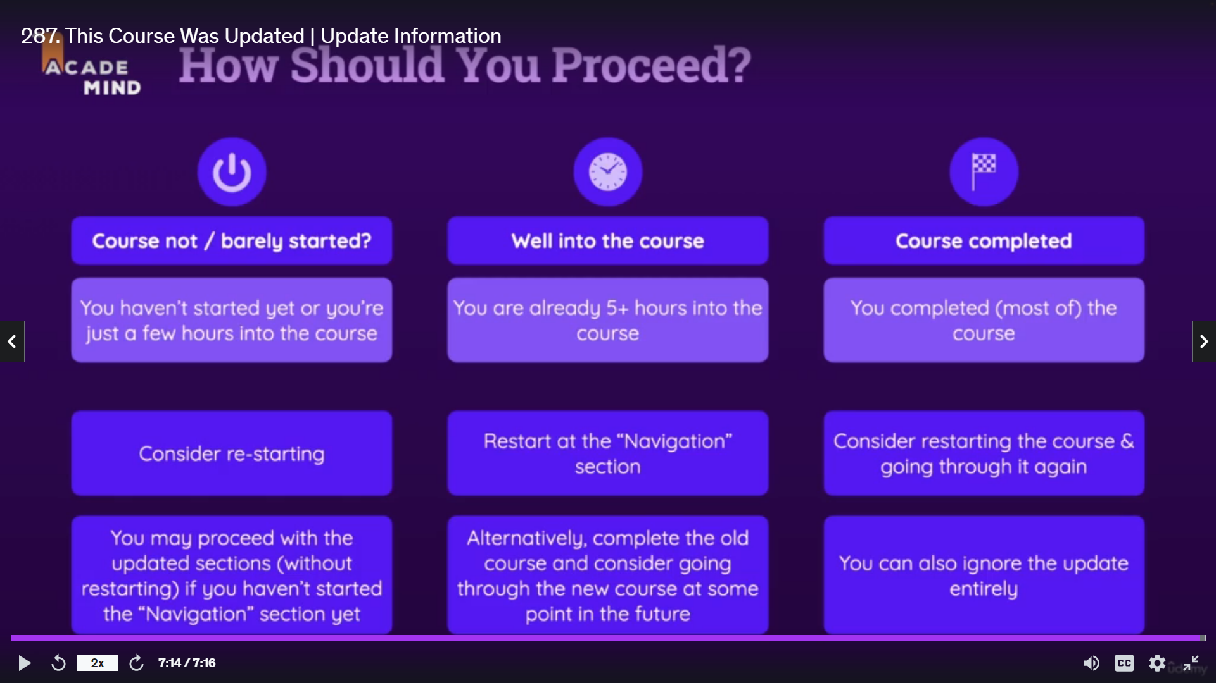

Slide 46
Course Update Information & FAQs

Slide 47
Bonus: More Content!
I got a lot of other high-quality & bestselling courses you might be interested in: https://academind.com/courses
I'd love to welcome you on board of any of these courses! :-)
Also don't forget to subscribe to my newsletter on https://academind.com/ to receive the latest updates and exclusive offers!
And in case you didn't know: On the same page as well as on my YouTube channel I got loads of additional tutorials.
Last but not least - I tweet on @maxedapps and on @academind_real, would love to see you there!

